Slide 1
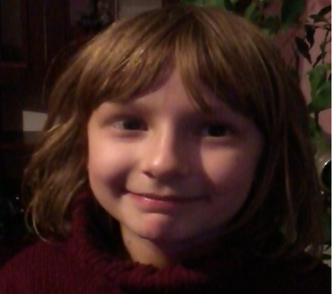
,,Popular sports in Poland”
Wykonanie
Adrianna Ciesiełkiewicz klasa IVb
Sport should change your life!!!

Slide 2
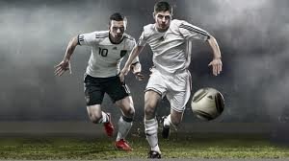
,,Popular sports in Poland”
Football

Slide 3
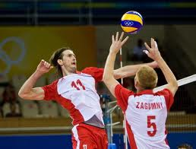
,,Popular sports in Poland”
Volleyball

Slide 4
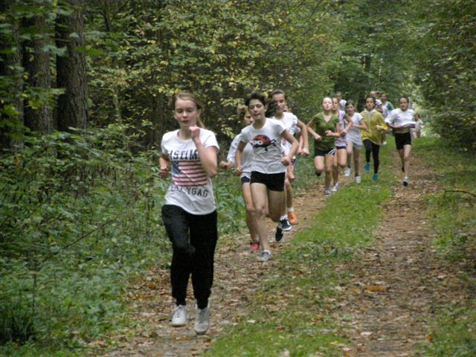
,,Popular sports in Poland”
Cross-country

Slide 5
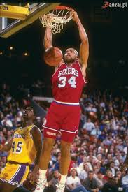
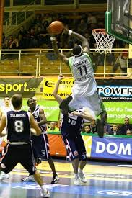
,,Popular sports in Poland”
Basketball

Slide 6
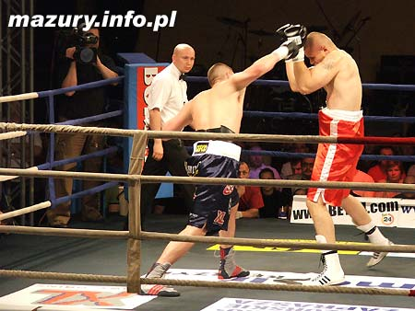
,,Popular sports in Poland”
Boxing

Slide 7
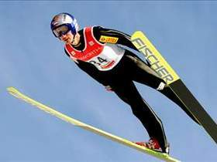
,,Popular sports in Poland”
Ski Jumping

