Slide 1
POPULAR SPORT IN POLAND
Autor: Aleksandra Kręzel

Slide 2
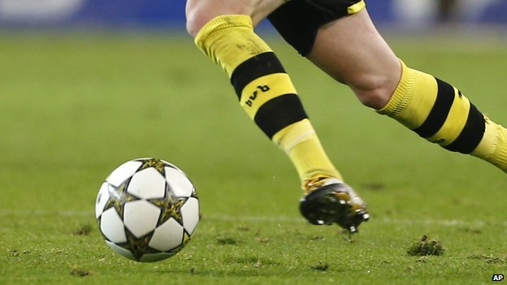
FOOTBALL

Slide 3
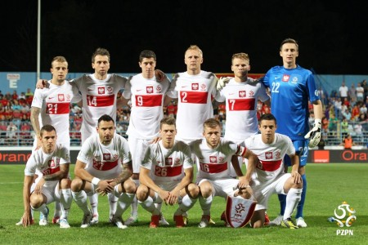
POLISH NATIONAL FOOTBALL TEAM

Slide 4
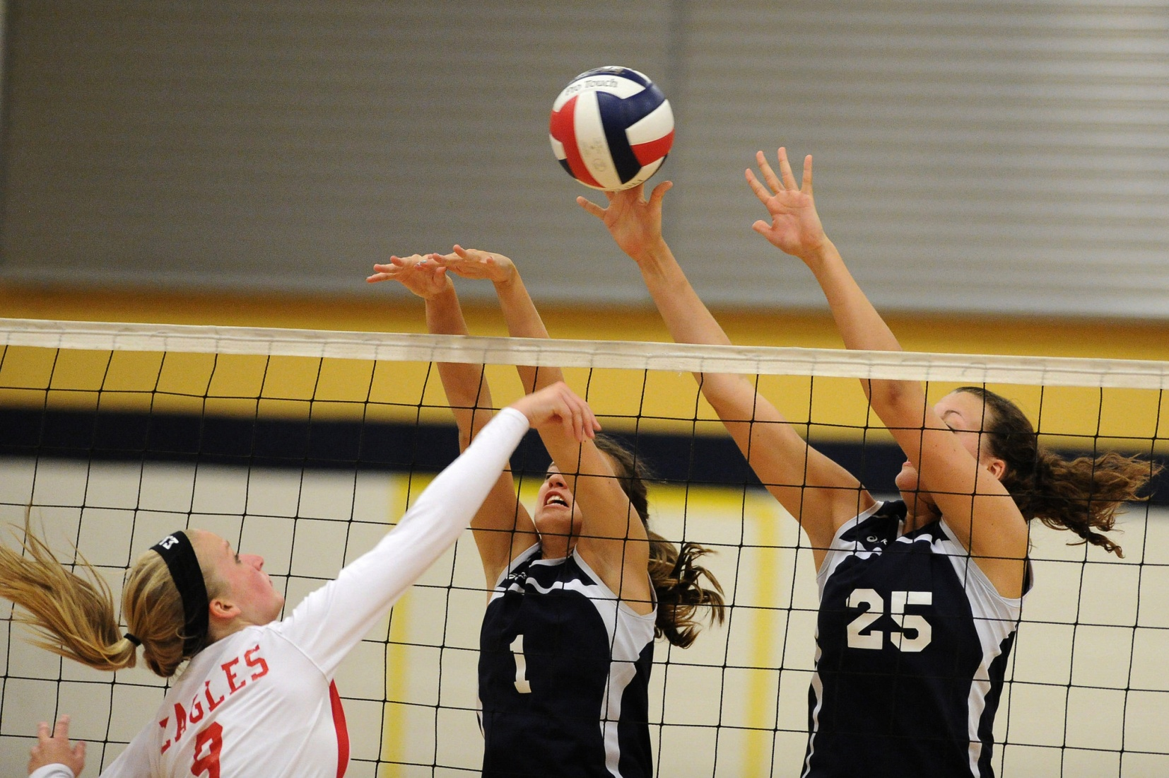
VOLLEYBALL

Slide 5
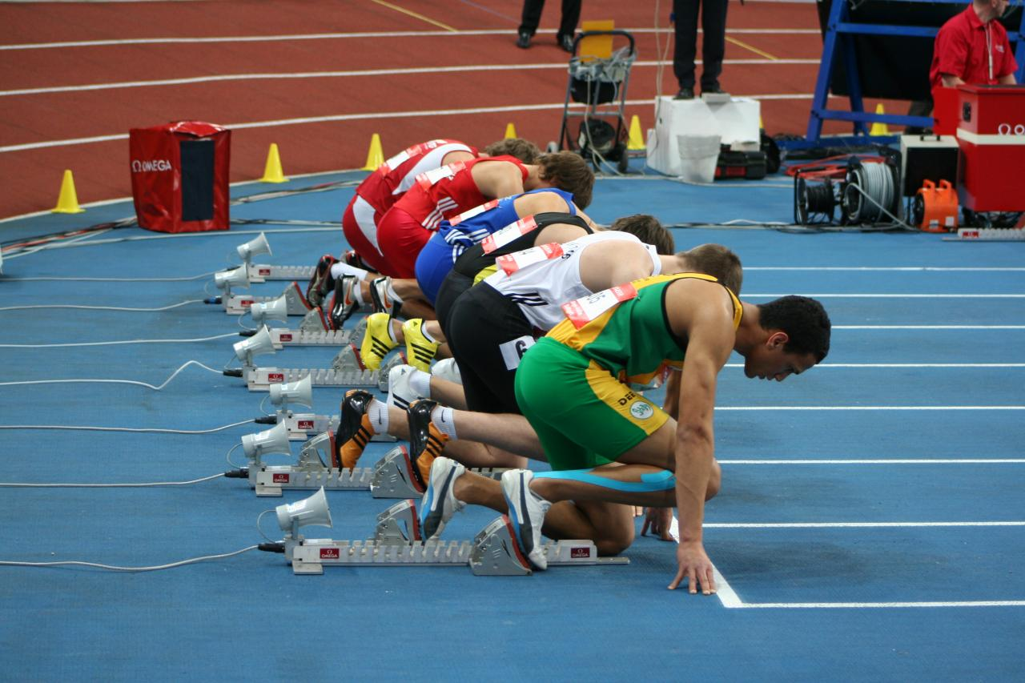
ATHLETICS

Slide 6
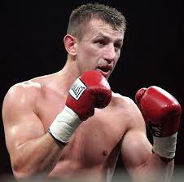
BOXING

Slide 7
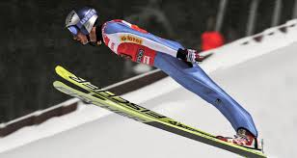
SKI JUMPING

Slide 8
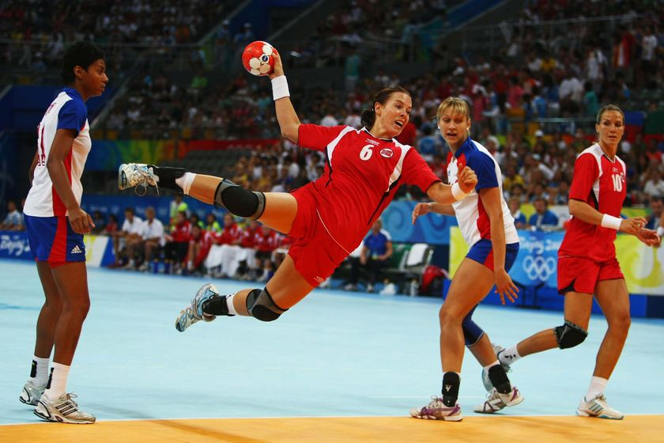
HANDBALL

Slide 9
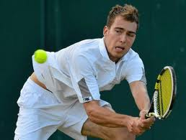
TENNIS

Slide 10
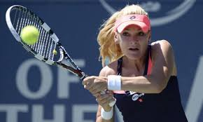
AGNIESZKA RADWAŃSKA
POLISH TENNIS PLAYER

Slide 11
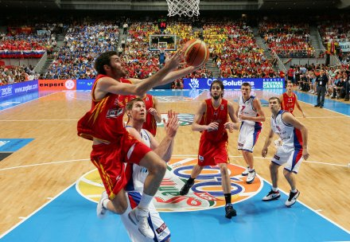
BASKETBALL

Slide 12
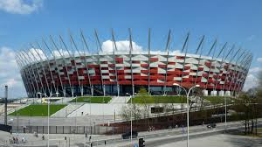
National stadium in Warsaw

Slide 13


