Slide 1
Sports in Poland
Dagmara Wrocińska
Klasa VIa

Slide 2
FOOTBOLL

Slide 3
VOLLEYBALL

Slide 4
BASKETBALL

Slide 5
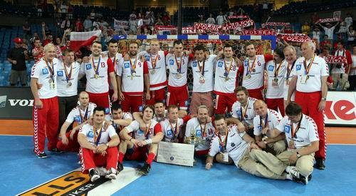
Handball

Slide 6
Hockey

Slide 7
RACING

Slide 8
CROSS-COUNTRY SKIING

Slide 9
SKI JUMPING

