Slide 1
Popular sports in Poland
Miłosz Dawidziak kl. 5A

Slide 2
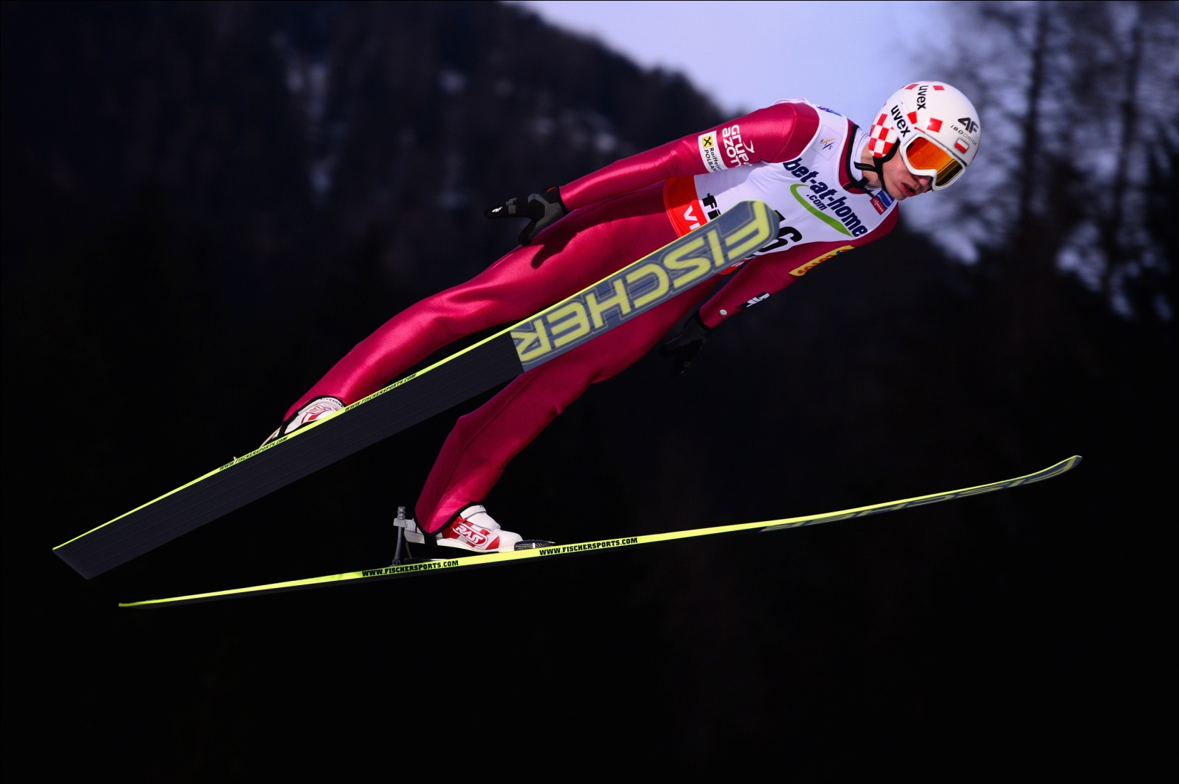
Ski Jumping

Slide 3
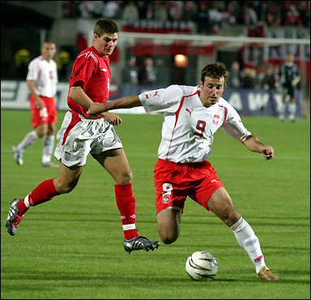
Football

Slide 4
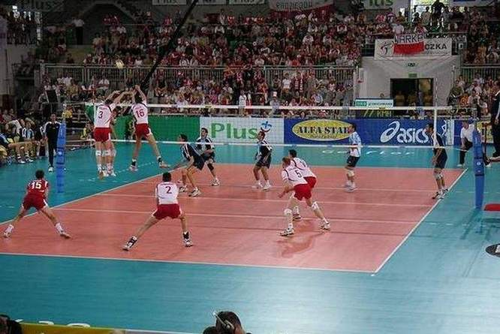
Volleyball

Slide 5
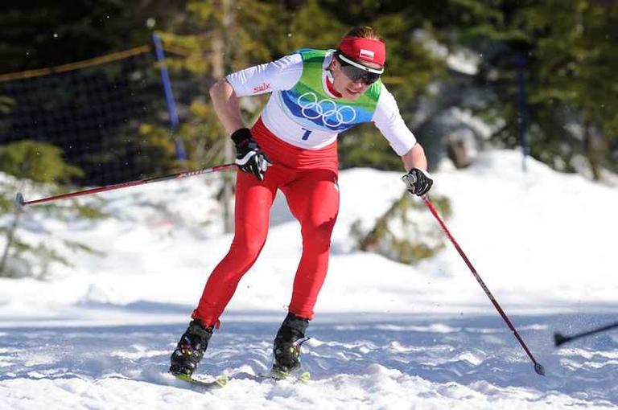
Cross-country skiing

Slide 6
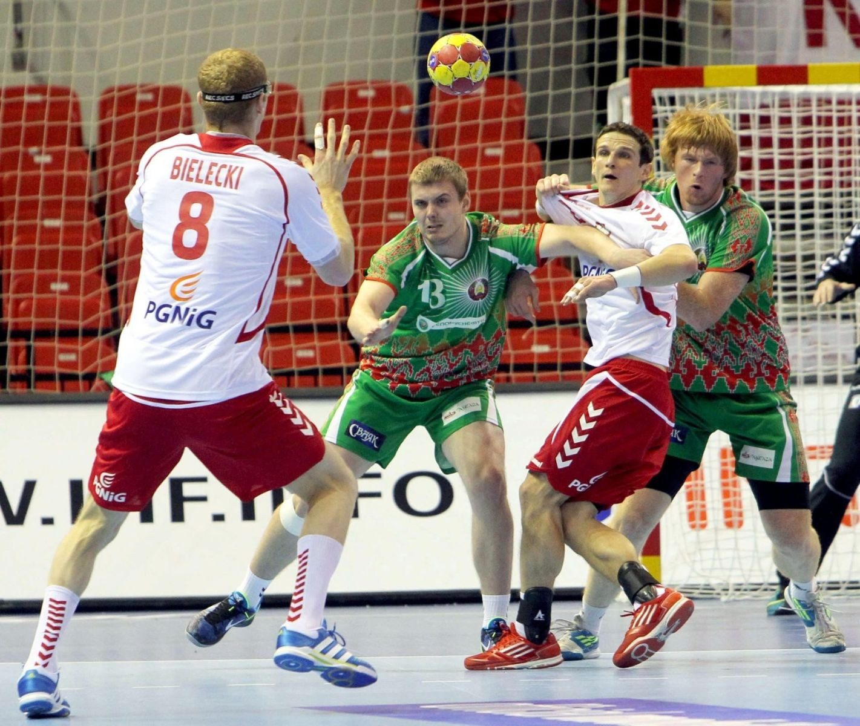
Handball

Slide 7
The end!

