Slide 1
Popular sports in Poland

Slide 2
In Poland there are a lot of winter sports and summer. Summer sports include: swimming, athletics, gymnastics, basketball, badminton, bowling, cycling, football, golf, handball, tennis, volleyball, ski jumping.
A lot of people from Poland win and achieve sport successes.
More and more people are involved in sports. Many children and young people play various games at school and after school.
Children, young people and older people are willing to participate in sports. Sport is a lot of fun.
I also like sport a lot.
The motto for the athletes to "Sport is good for health!''

Slide 3
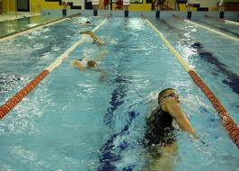
Swimming

Slide 4
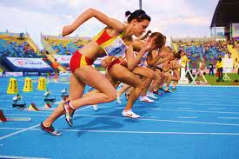
Athletics

Slide 5
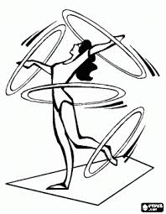
Gymnastics

Slide 6
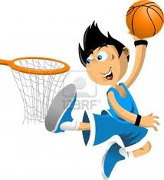
Basketball

Slide 7
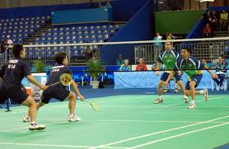
Badminton

Slide 8
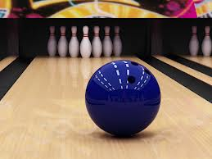
Bowling

Slide 9
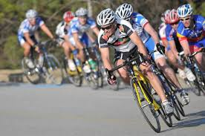
Cycling

Slide 10
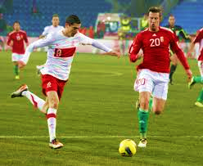
Football

Slide 11
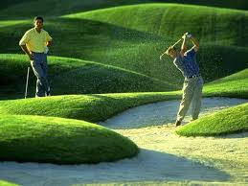
Golf

Slide 12
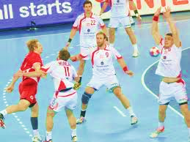
Handball

Slide 13
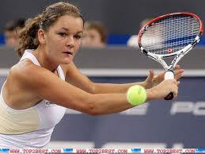
Tennis

Slide 14
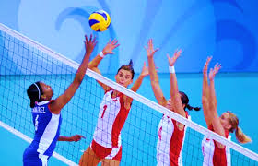
Volleyball

Slide 15
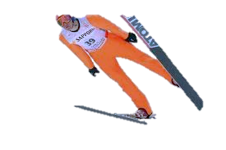
Ski jumping

Slide 16
Thanks for your attention !!! Dominika Lipa Klasa VI B

