Slide 1
Fáilte!
Realt na Mara BNS Welcomes You!

Slide 2
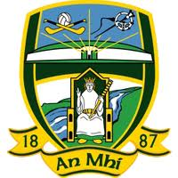
County Meath
As told by the Fifth Class of
Réalt na Mara Boys’ National School,
Donacarney,
Mornington,
County Meath.

Slide 3
County Meath
Ireland is divided into 4 provinces and 32 counties.
Meath is located on the east coast of Ireland and is in the province of Leinster.
Meath is known as ‘The Royal County’.
Our school is on the border between Meath and Louth and is about 20 miles from Dublin.

Slide 4
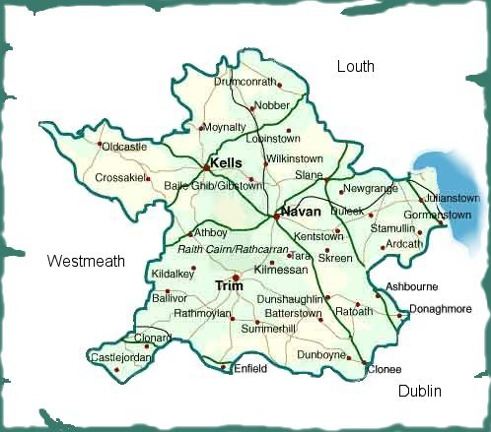
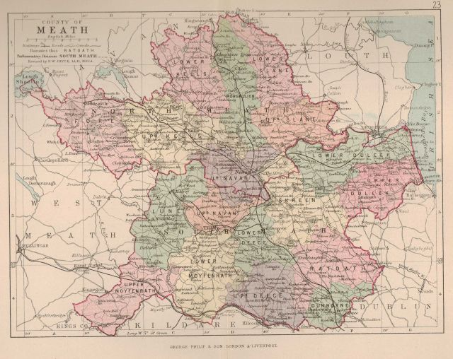
Places of interest
Meath is a very important place in Irish history.
There are strong links to ancient Irish history all over the county.

Slide 5
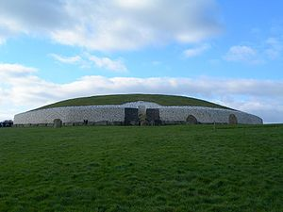
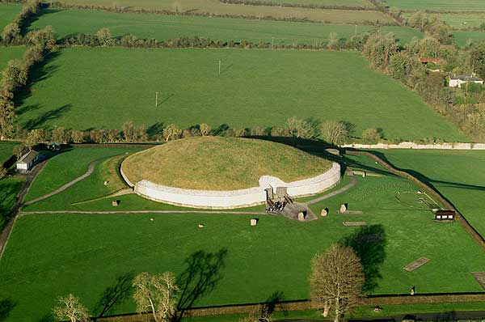
Newgrange
Newgrange is an ancient temple that was built ovr 5,000 years ago.
It is the best example of a passage tomb and is one of Ireland’s main tourist attractions.

Slide 6
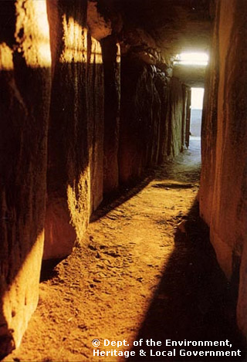
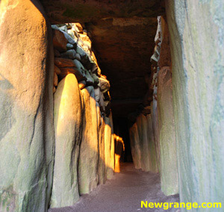
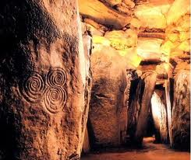
The Winter Solstice at Newgrange
The winter solstice occurs every year and on this day the inner chamber of the tomb is fully illuminated by light.
This event shows how carefully the site was constructed and how advanced the builders of Newgrange were.

Slide 7
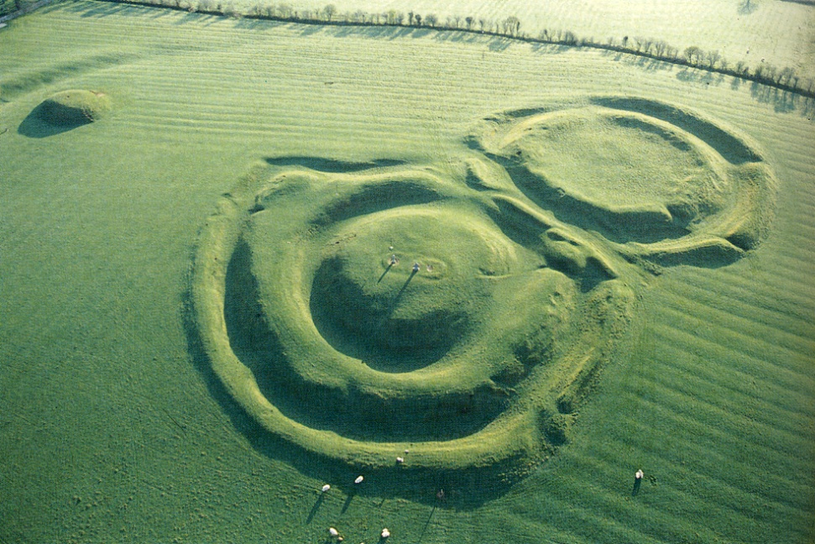
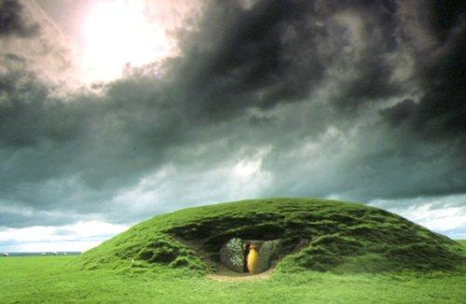
The Hill of Tara
The Hill of Tara is an ancient site that is said to be the home of the High King of Ireland.
The site contains many ancient monuments and hints to Ireland’s past.

Slide 8
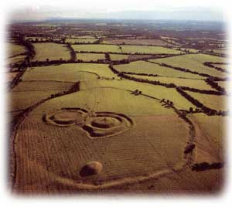
An aerial view showing the site at the Hill of Tara.
The boundaries of the old settlements can clearly be seen in this picture.

Slide 9
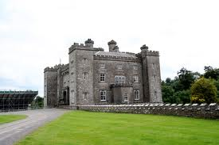
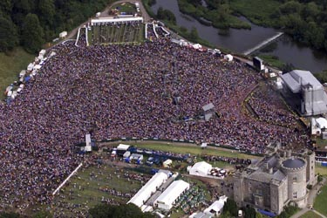
Slane Castle
Slane Castle is a 200 year old castle that has become famous all over the world for staging rock and pop music concerts.
Every year since 1981, approximately 80,000 people travel to Slane to see acts such as The Rolling Stones, Bruce Springsteen and Oasis.

Slide 10
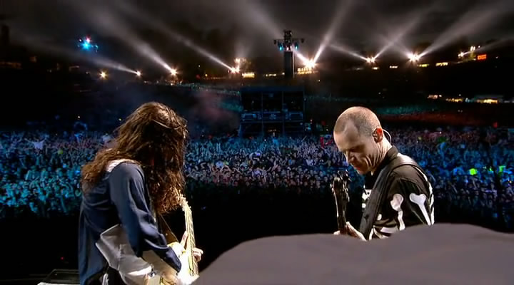
The Red Hot Chilli Peppers perform at Slane Castle in 2003.

Slide 11
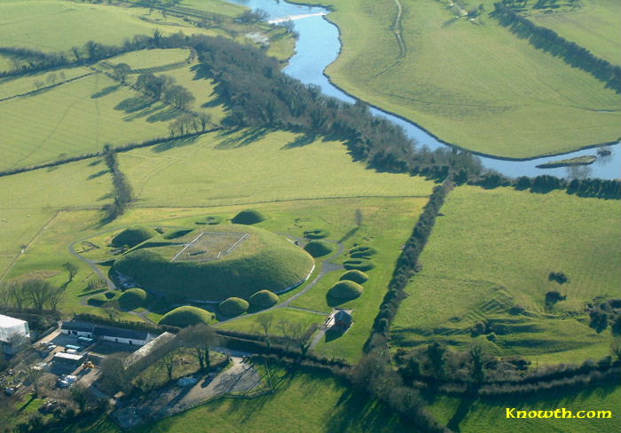
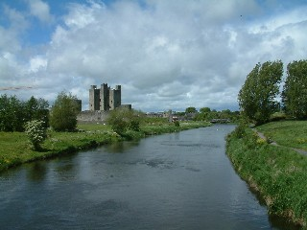
The River Boyne
The River Boyne is one of Ireland’s main rivers and reaches the Irish Sea near Mornington.
It was the site of the Battle of the Boyne in 1690, a hugely important point in Irish history.
The Boyne is also said to be the river where Fionn mac Cumhaill caught the Salmon of Knowledge, a famous Irish story.

Slide 12
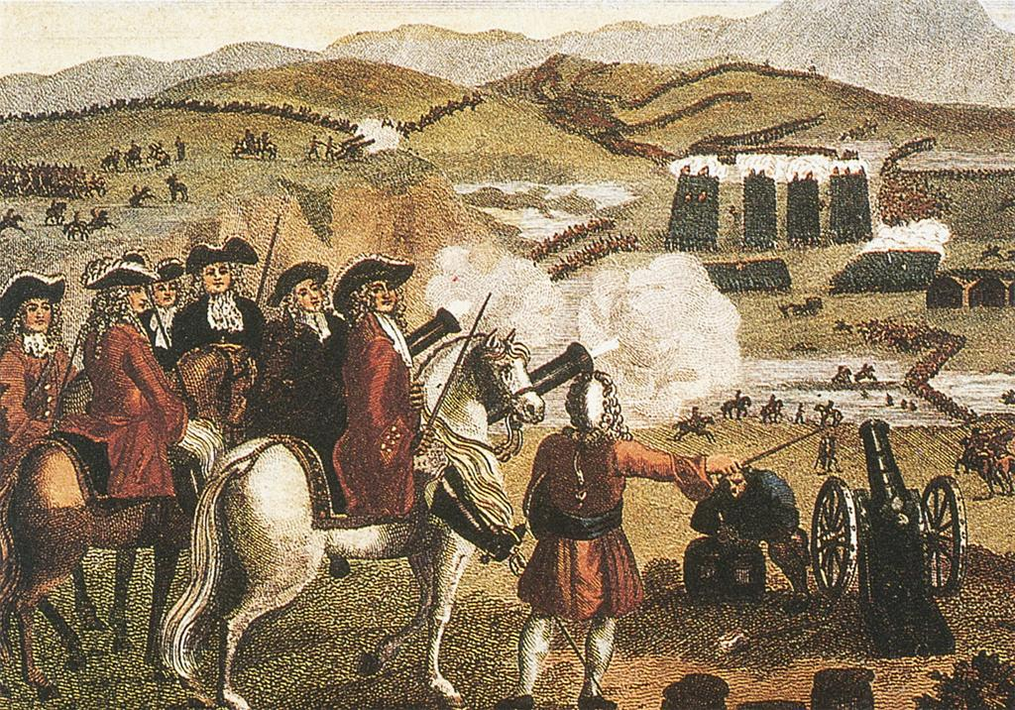
A picture portraying The Battle of The Boyne in 1690 .
The battle was fought between the armies of King James and King William for the right to claim the thrones of Ireland, Scotland and England.

Slide 13
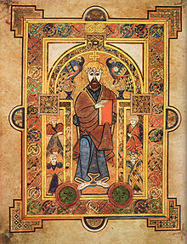
The Book of Kells
The Book of Kells is a richly decorated copy of the New Testament that is famous all over the world.
It was created by monks from the Abbey of Kells in county Meath over a thousand years ago.
The Book is famous for its beautiful illustrations and writing.

Slide 14
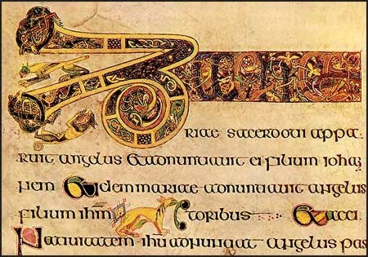
An example of the amazing work found in the Book of Kells.
The book is on permanent display in Trinity College, Dublin, where it has been seen by millions of people,

Slide 15
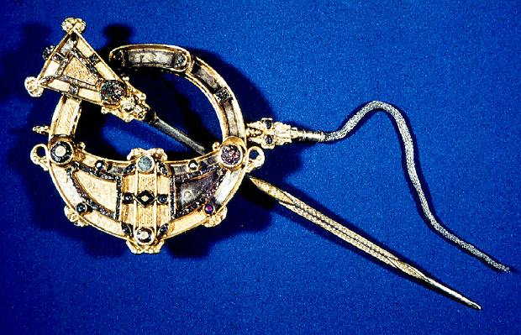
Tara Brooch
The Tara Brooch was made in the 8th century.
It was found on a beach near our school in the 1850s.
It is on display in the National Museum of
Ireland, Dublin.

Slide 16
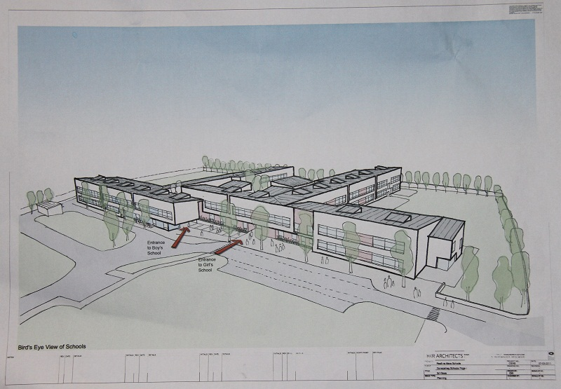
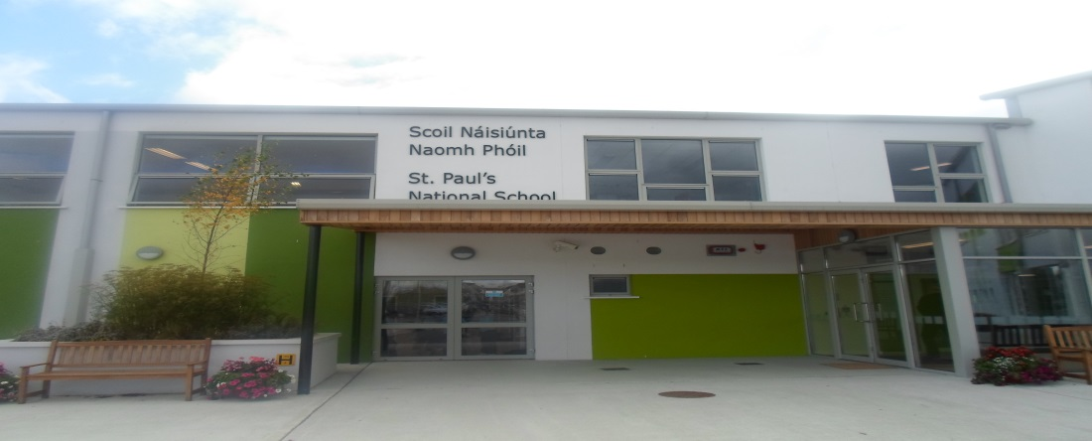
Donacarney schools
Primary school established in 1884 Plan for our new school
Our current school built in 1964 New school will be opened in 2014

Slide 17
Education System
Primary School age 4 Post Primary: Ages 12-18
Leave Primary age 12 Third Level open to pupils of 17+
English, Irish, Maths,
Social Environmental Scientific Education
Music, Art, Physical Education
Religion

Slide 18
Green Flag Programme
Green Flag programme started in 2003
Compost all our raw food waste
Use recycle bins in all classes
Conserve energy
Built wildlife gardens and vegetable plots
Working to get our green flag for travel
Encouraging carpooling and walking to school.

Slide 19
Sports
Very strong sporting tradition in our school
Rugby, athletics, gaelic football, hurling, swimming,

Slide 20
Ireland of the Welcomes…
Two official languages in Ireland-Irish and English
Half a million people in Ireland speak another language in their homes.
Polish is most frequently spoken followed French, Lithuanian and German
At least 160 different languages spoken in Ireland
Thirty different languages spoken in our school.

Slide 21
…Welcomes You
We are delighted to welcome our Comenius partners to Ireland.

