Slide 1
Holice

Slide 2
Holice located in the Czech Republic, in the Pardubice region
The city ​​consists of 7 parts: Holice, Old Holice, Podhráz, Podlesí, Koudelka, Roveňsko and Kamenec.
The first mention is from 1336.

Slide 3
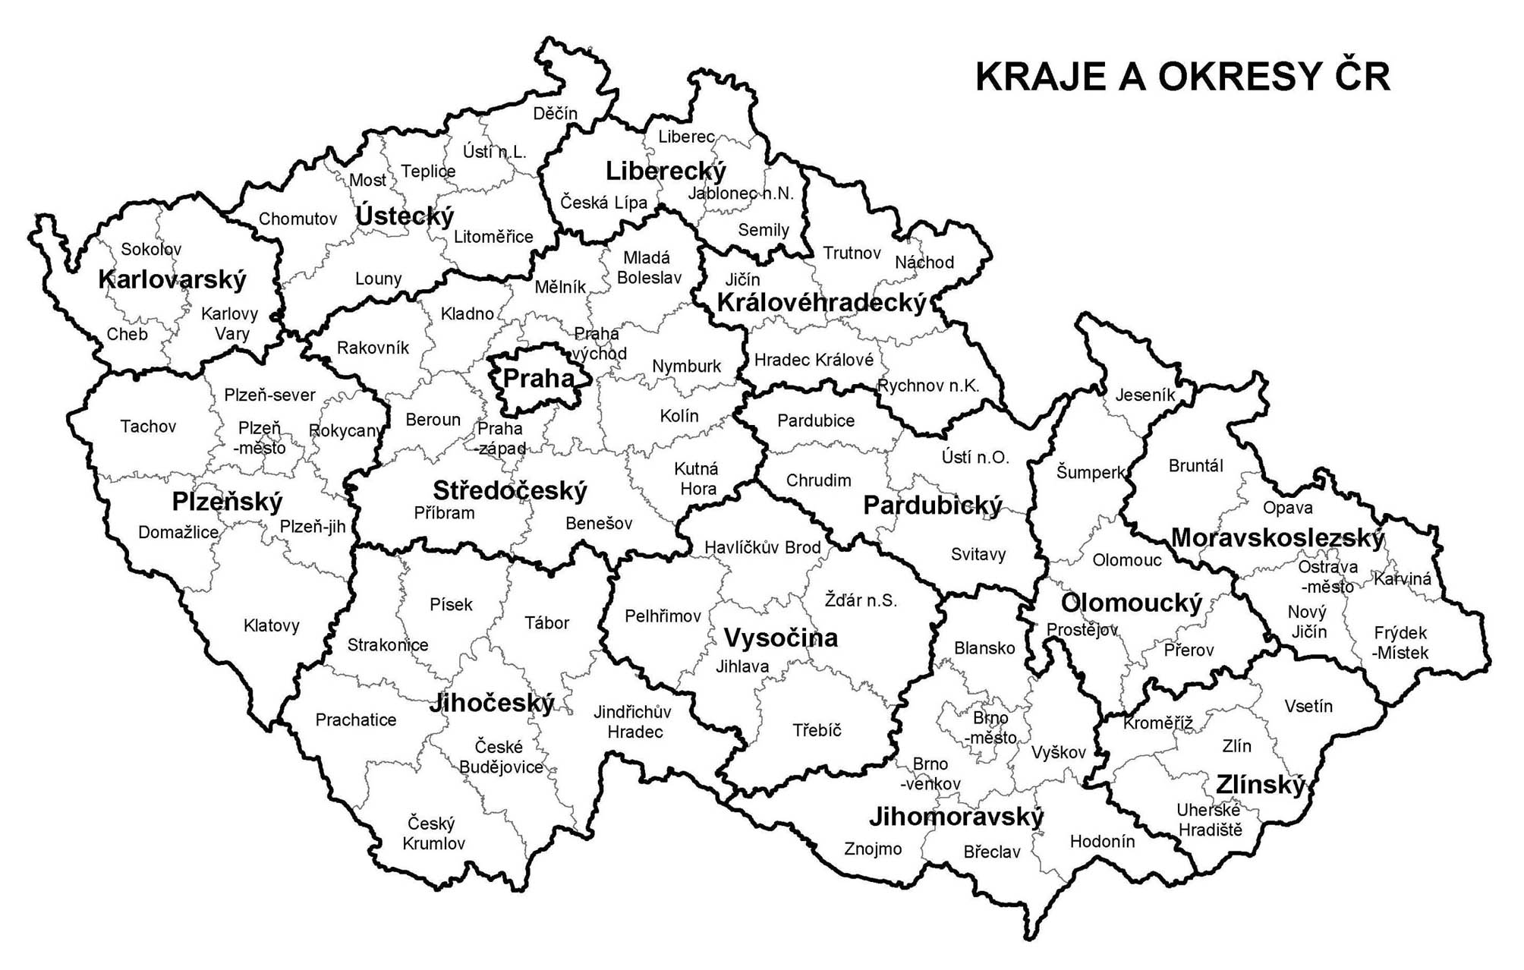
Holice

Slide 4
interesting places
Church st. Martin
Stone cross on T. G. Masaryk square from 1803
African museum Dr. Emil Holub
Motocross racing in Poběžovice. There is a world championship every year.
House of Culture
and other interesting places…

Slide 5
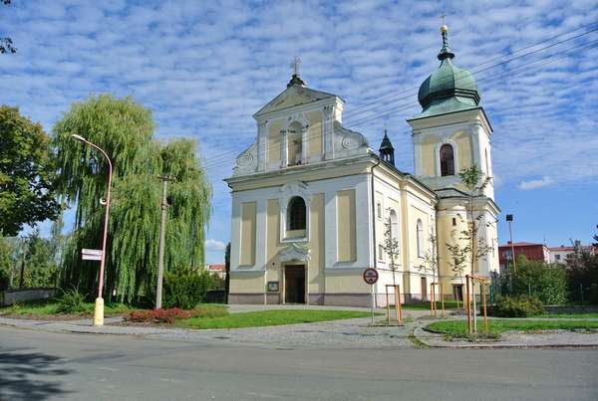
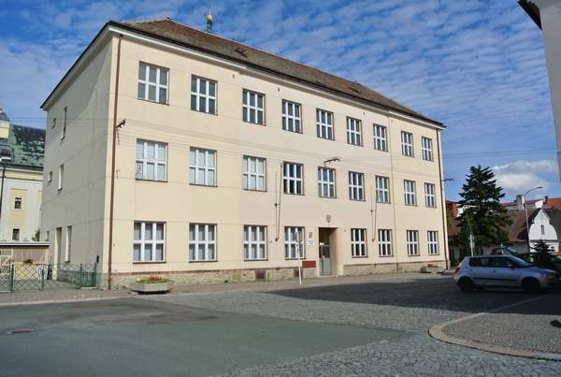
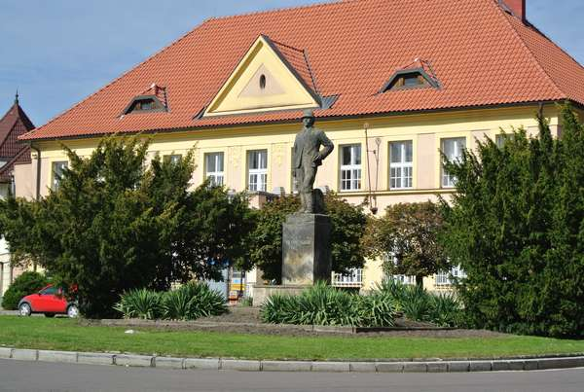
Church st. Martin
Museum Dr. Emil Holub
Our School

Slide 6
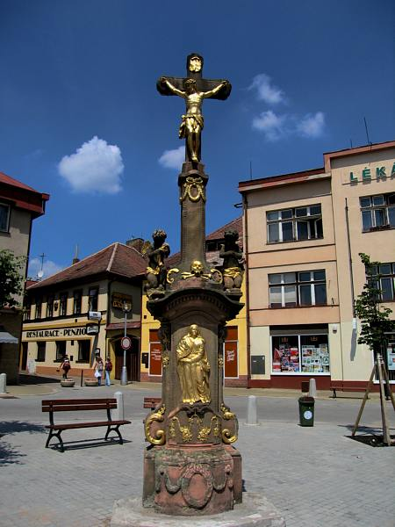
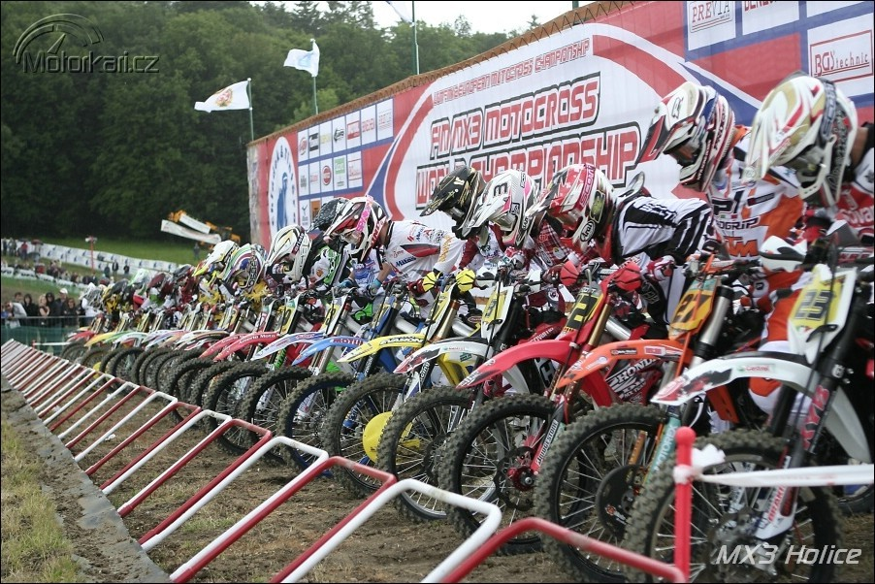
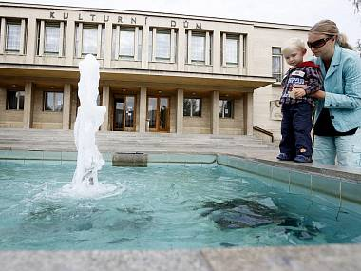
Motocross racing Poběžovice
Stone cross on T. G. Masaryk square
House of Culture

Slide 7
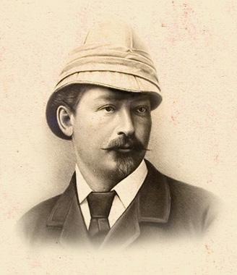
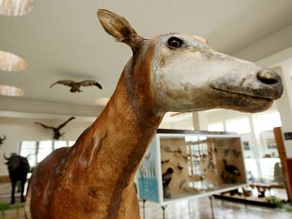
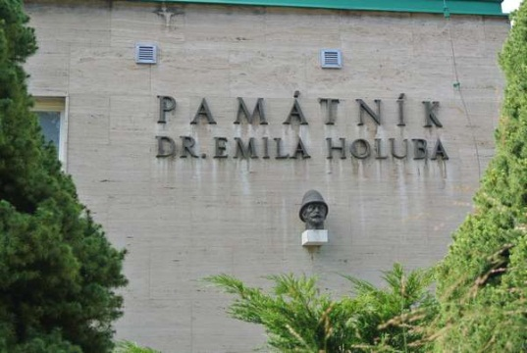
Museum Dr. Emil Holub
There are African stuffed animals and items that you brought back from his travels E. Holub.

Slide 8
Famous people
Václav Bauman was pilot. He is hero of the Battle of Britain.
Emil Holub discovered South Africa.
Jan Kačer is actor and director.
Jiří Welsch is basketball player.
Josef Malejovský was the famous sculptor.

Slide 9
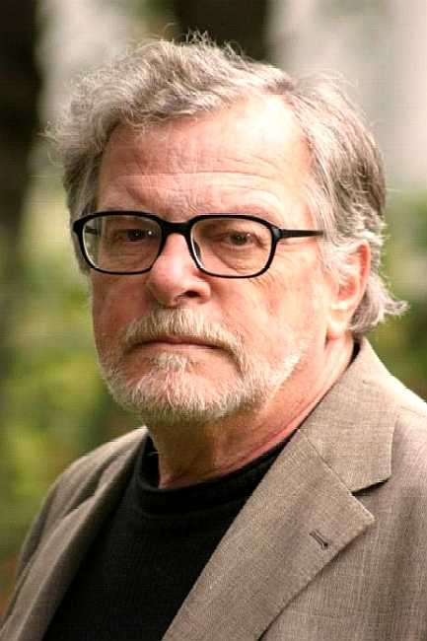
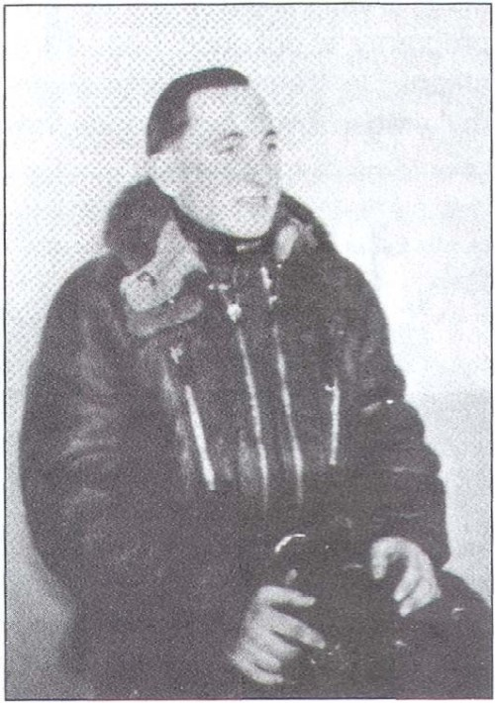
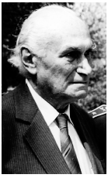
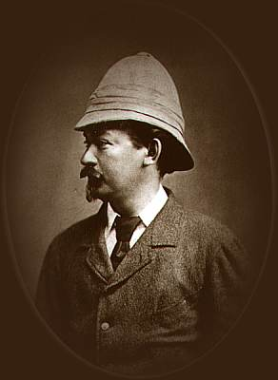
Václav Bauman
Josef Malejovský
Jan Kačer
Dr. Emil Holub

Slide 10
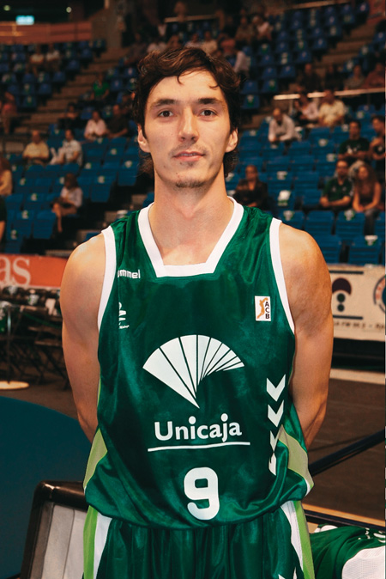
Jiří Welsch
27. leden 1980
profesional basketball player
Jiri Welsch is pupil BVK Holice.
He represented Czech republic.
Now, he playing in Spain,
in CB Estudiantes Madrid.

Slide 11
