Slide 1
Popular Sports in Poland
Jakub Kępiński

Slide 2
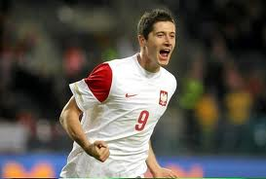
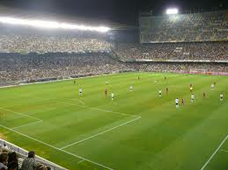
Popular sports in Poland: FOOTBALL

Slide 3
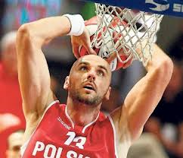
Popular sports in Poland: BASKETBALL

Slide 4
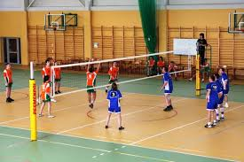
Popular sports in Poland: VOLLEYBALL

Slide 5
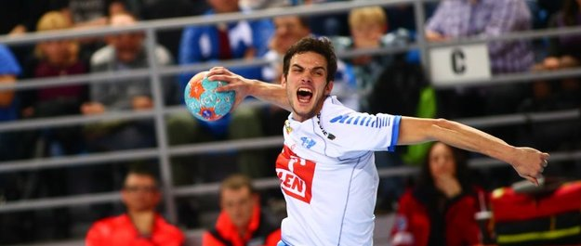
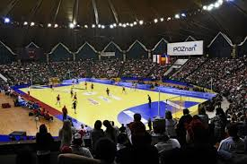
Popular sports in Poland HANDBALL

