Slide 1
Popular sports in Poland
Live actively any time of the day or night!

Slide 2
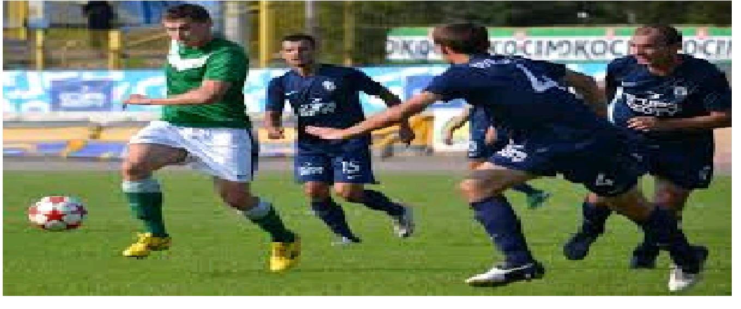
Football

Slide 3
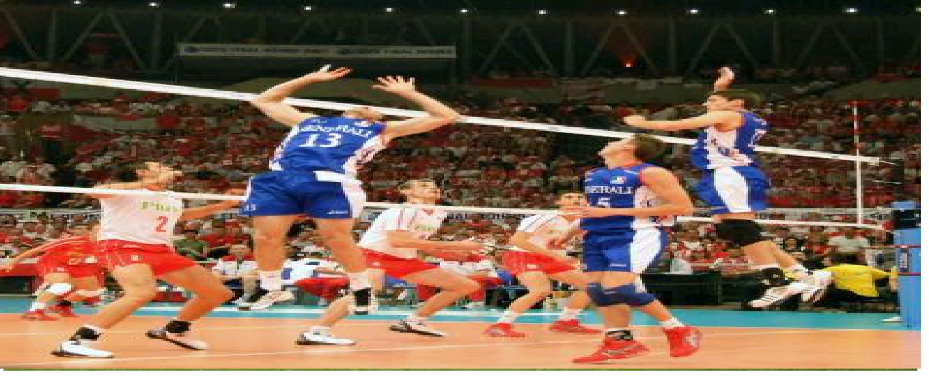
Volleyball

Slide 4
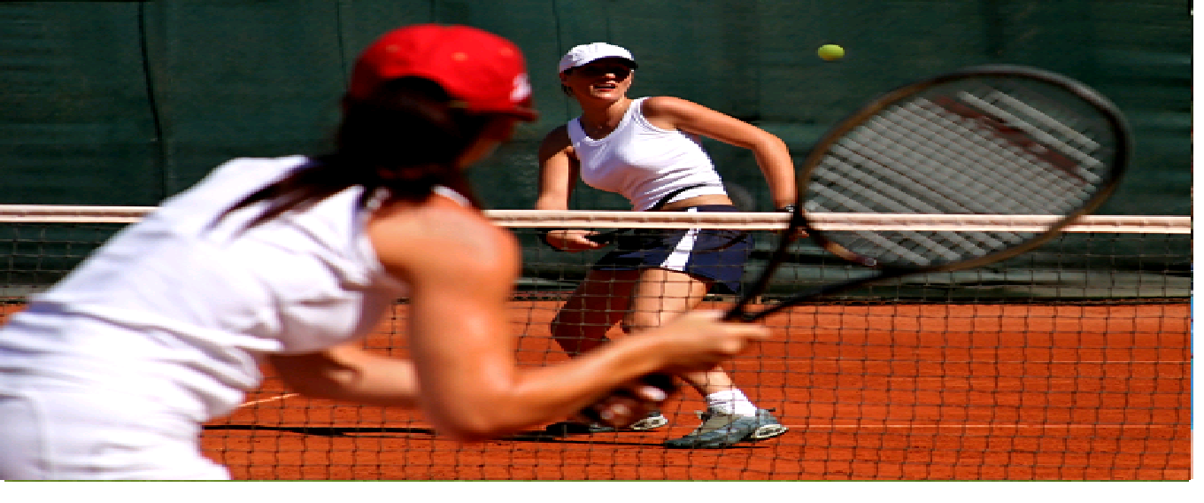
Tennis

Slide 5
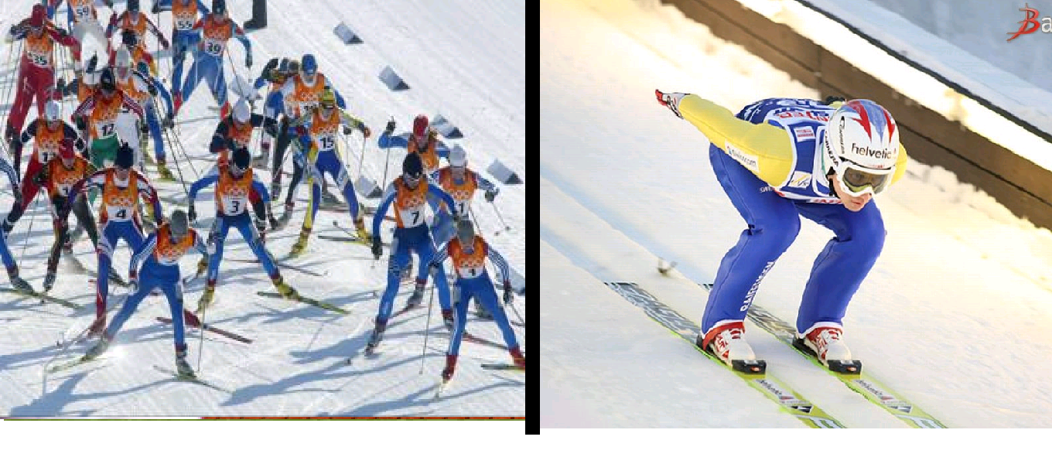
Cross-country skiing and
Ski jumping

