Slide 1
Popular Sports In Poland

Slide 2
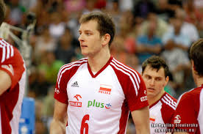
Volleyball

Slide 3
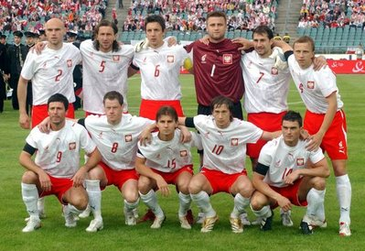
Football

Slide 4
Tennis

Slide 5
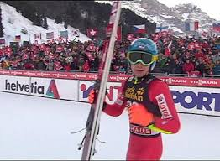
Ski-Jumping

Slide 6
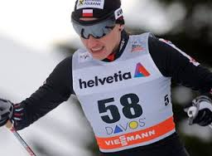
Cross-Country Skiing

Slide 7
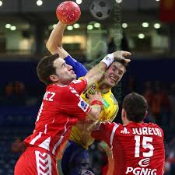
Handball

