Slide 1
Popular sports in Poland

Slide 2
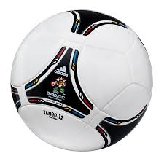
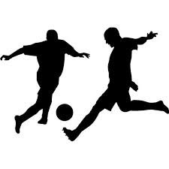
football
Football involves shooting goals to the opponent's goal, who gets the most wins. Unfortunately, some players cheat foul an opponent. Playing in this game on the fields and stadiums.

Slide 3
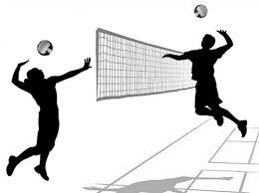
volleyball
Volleyball is a game where the game just hands. The team that the match score as many sets wins. The game is closely following the judge. In this game usually takes place on the beaches, stadiums, playing fields and sports halls.

Slide 4
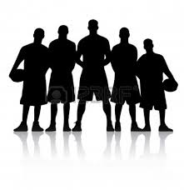
basketball
Basketball is a game in which dribbles the ball and pass to other players. The player who is on the attack shoots a basket ball and goes-it is called a basket or a point gained for the throw. In this game played on playgrounds, sports halls and stadiums.

Slide 5
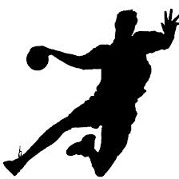
handball
Handball is a game where you use only your hands to pass the ball to players or throwing the ball into the opponent's goal. In this game the game is usually in gyms.

Slide 6
Hockey
Hockey is a game that uses the skates and sticks. In this game on the ice.
Uni hockey is a game for sport halls with her ​​clubs to the game.

Slide 7
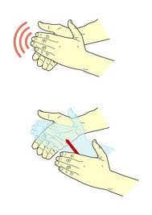
Thank you for your attention

