Slide 1
Popular sports in Poland.
Natalia Antczak ☺

Slide 2
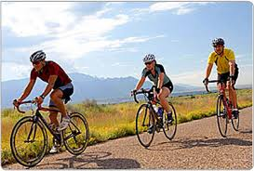
Cycling

Slide 3
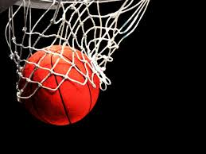
Basketball

Slide 4
Football

Slide 5
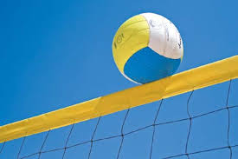
Volleyball

Slide 6
Thank you ☺

