Slide 1
Popular sports in Poland!!
Natalia Krawczyk kl.5a

Slide 2
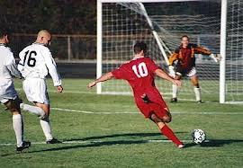
football

Slide 3
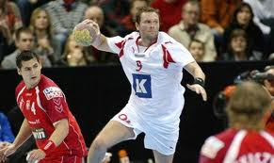
handball

Slide 4
volleyball

Slide 5
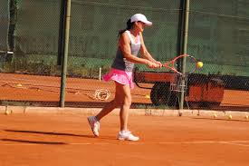
tennis

Slide 6
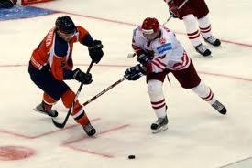
hockey

Slide 7
Thank you for watching my presentation!!

