Slide 1
POPULAR SPORTS IN POLAND

Slide 2
FOOTBALL

Slide 3
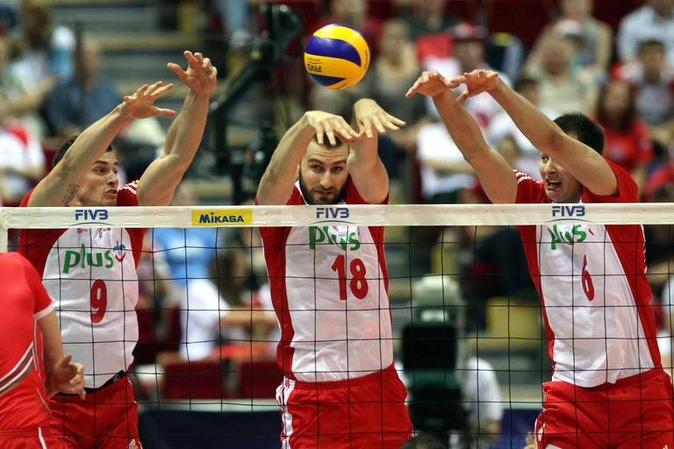
VOLLEYBALL

Slide 4
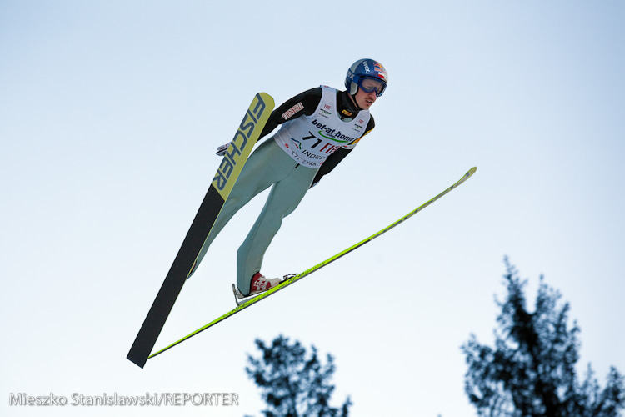
JUMPING

Slide 5
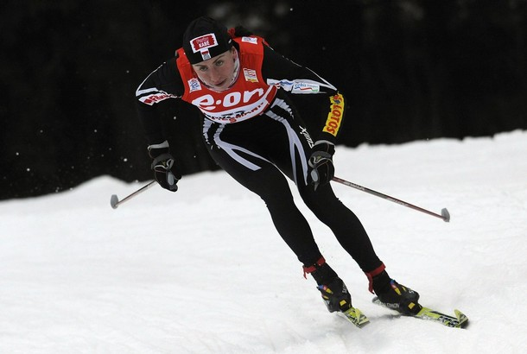
CROSS- COUNTRY
SKIING

Slide 6
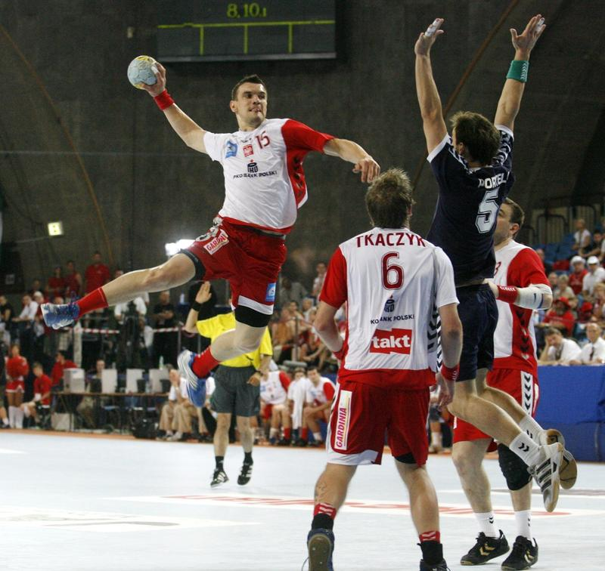
HANDBALL

Slide 7
TENNIS

Slide 8
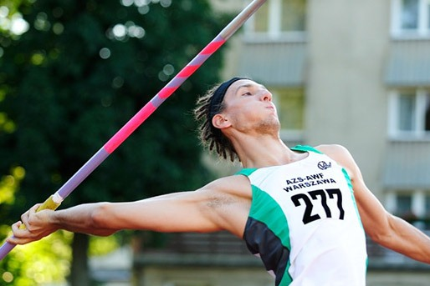
JAVELIN THROW

Slide 9
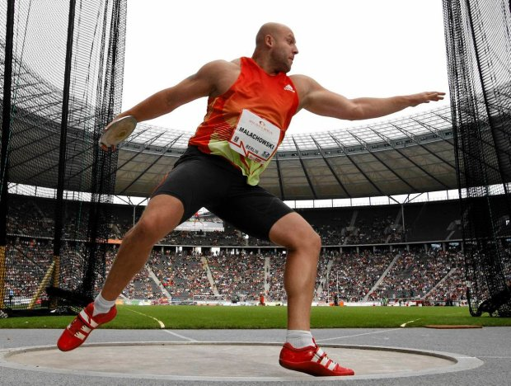
DISCUS THROW

Slide 10
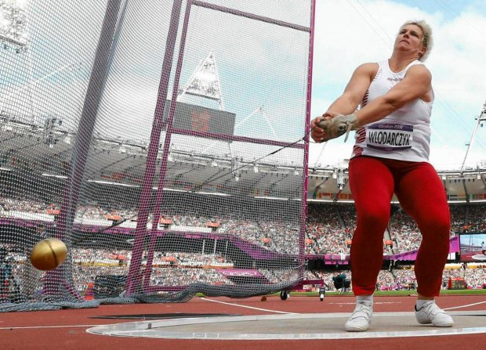
HAMMER THROW

Slide 11
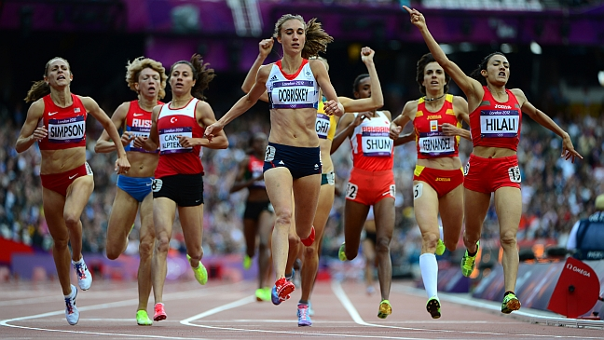
RACING

Slide 12
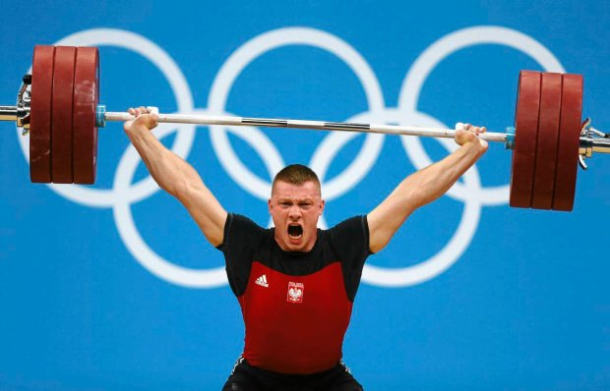
WEIGHTLIFTING

Slide 13
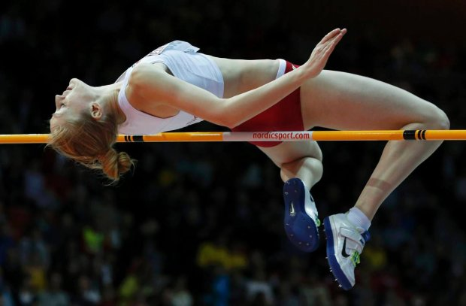
JUMP IN AND ABOVE

Slide 14
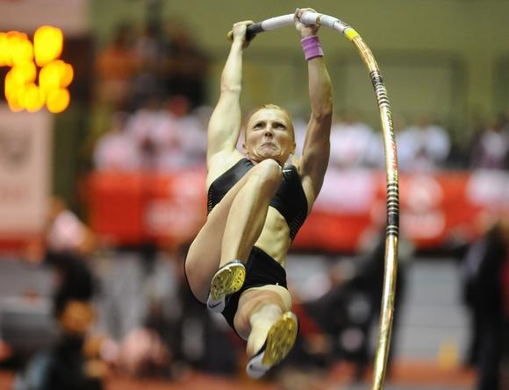
POLE VAULT

Slide 15
SWIMMING

Slide 16
THE END!

