Slide 1
Popular sports in my country

Slide 2
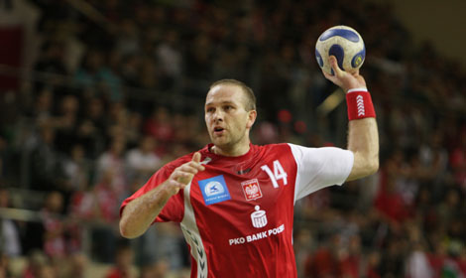
Handball

Slide 3
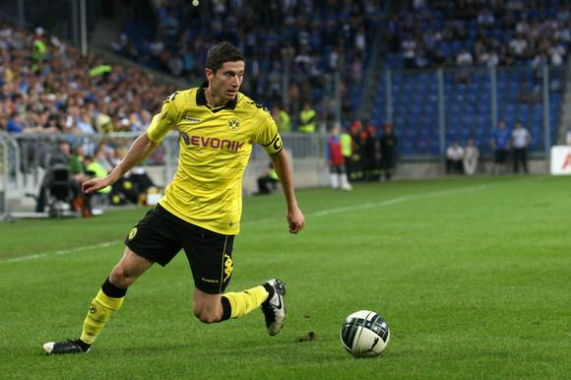
Football

Slide 4
Volleyball

Slide 5
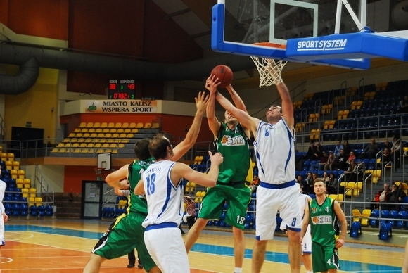
Basketball

Slide 6
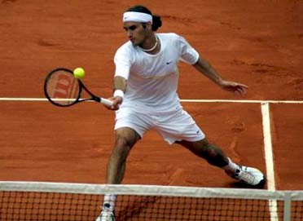
Tennis

Slide 7
Hockey

Slide 8
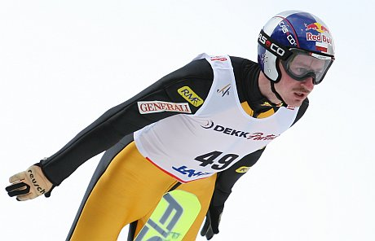
Ski Jumping

Slide 9
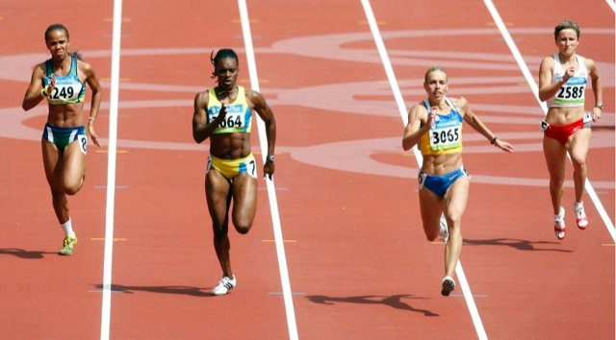
Racing

Slide 10
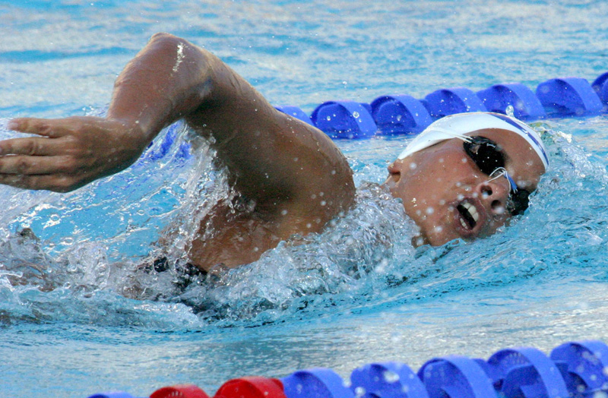
Swimming

Slide 11
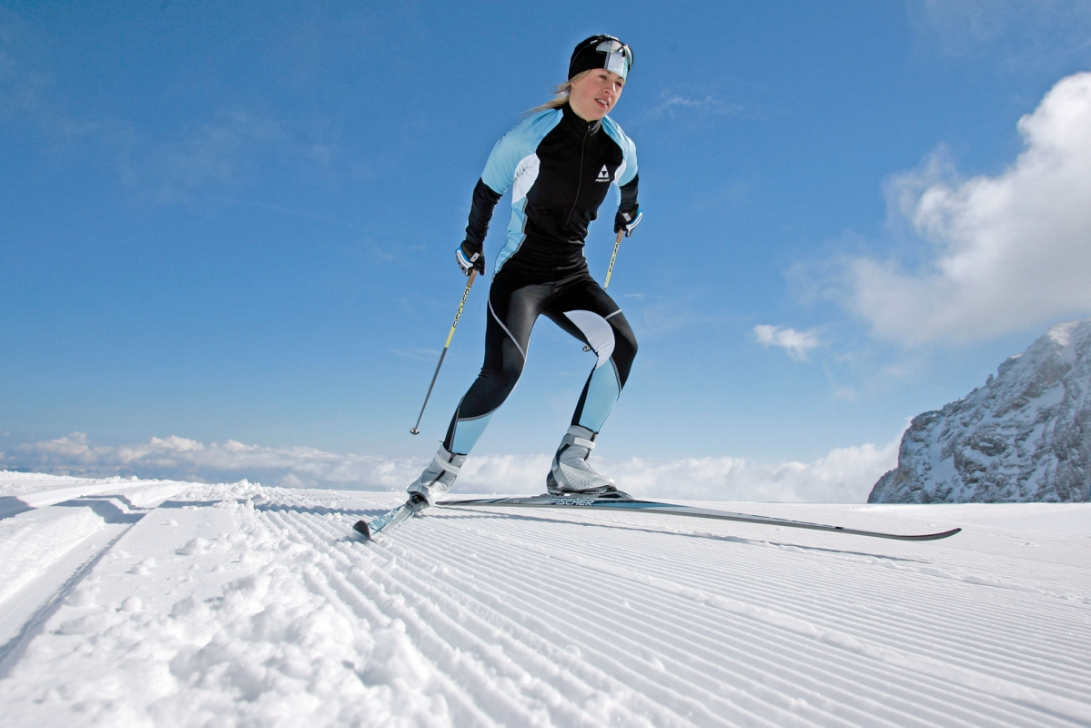
Cross-country skiing

Slide 12
Natalia Majka klasa 6a

