Slide 1
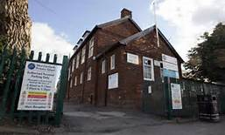
Our school West Cornforth Primary School

Slide 2
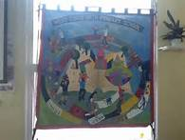
School banner
. Ks2 have been working on a school banner. A girl called Emma came to help us. It shows things that are important to us In our community and school council

Slide 3
School council and Comenius
We have school council in our school and two people from each class are the school council. We decide how to make our school green , sporty and healthy.

Slide 4
West Cornforth
West Cornforth is a village in County Durham. The nearest city is Durham – about 6 miles away!
Local people call West Cornforth “Doggie” because of the Dog iron that used to be used on the railway lines to hold the sleepers in place.
In this area there are a lot of quarries where they dig for limestone and other rocks.

Slide 5
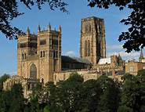
Durham cathedral
Durham Cathedral has a lovely café , a gift shop and lots more lovely things.
Durham Cathedral is a place of worship ,welcome and hospitality.
It is famous for the Shrines of St Cuthbert and St Bede

Slide 6
Foundation Stage Unit
In the foundation stage unit we have children from the ages of 2-4 years old. We now have a special 2 year olds room!
We have chickens too!

Slide 7
Ks1 & ks2
ks1
ks2
Key stage 1 children go from the age of 5 up to the age of 7 years old.
We have 2 ks1 classes in our school.
Key stage 2 children go from the age of 7 up to the age of 11 years old.
We have 4 ks2 classes in our school .

Slide 8
Play time & lunch time
Our lessons start at 9:00am and finish at 10:45am unless we have assembly at 10:30am.
We have playtime for 15 minutes , and have lots of things to play with . Like…
The climbing wall and frame and also we have a little play kitchen for the Ks1
We go for our lunch at 12:15pm and go back to class at 1:00pm

Slide 9
After School Clubs
We have lots of after school clubs for people to go to if they want to enjoy themselves. They are free and they start at 3pm and finish at 4pm.
Comenius Club
Computer Club
Energy Club
Cricket Club
Film Club
Dance Club
Cookery Club
Booster sessions for year 6
Science Club
Basketball/ Netball
Football
Sing For Fun Club
We go to lots of festivals for sport and compete with other schools!

Slide 10
Thanks for listening about us and our area.

Slide 11
Would you like to know anything else ?

