Slide 1
„Popular sports in Poland”
Wykonała: Patrycja Lewandowska kl. VI B

Slide 2
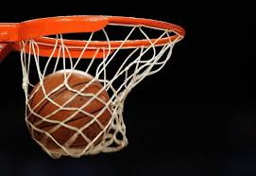
Basketball

Slide 3
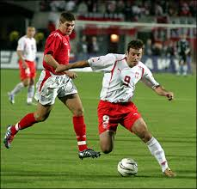
Football

Slide 4
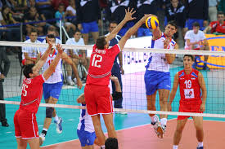
Volleyball

Slide 5
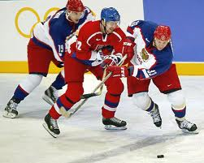
Hockey

Slide 6
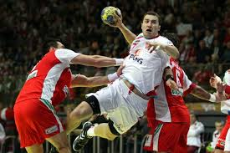
Handball

Slide 7
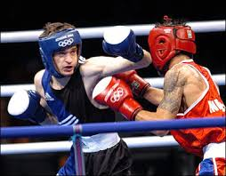
Boxing

Slide 8
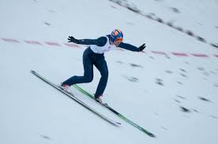
Ski jumping

Slide 9
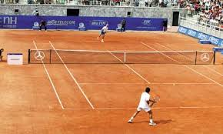
Tennis

