Slide 1
„Popular sports in Poland’’

Slide 2
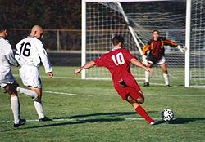
„Popular sports in Poland’’

Slide 3
„Popular sports in Poland’’
football - a team game. Football fans claim that it is the most popular sport at the world

Slide 4
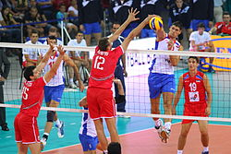
„Popular sports in Poland’’

Slide 5
„Popular sports in Poland’’
Football, volleyball - a team sport in which (in the traditional, classical variation ie indoor volleyball) involves two six-member teams, each: quarterback, the attacker, two middle and two receiving and libero - on the pitch stays but only six players, libero varies with the center, when the team takes lick.

Slide 6
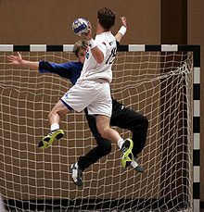
„Popular sports in Poland’’

Slide 7
„Popular sports in Poland’’
Handball (colloquially pol. Handball,) - a team sport discipline (team game), grown around the world - both by women and by men - which involved two teams after the 7 players each. The aim of the game is dropping - using only your hands - the ball into the opponent's goal. The ball may be thrown, pushed, fiber sludge, struck and stopped. Players, except goalkeepers have no right to do more than 3 steps with the ball in his hands, forcing dribbled the ball and run with numerous

Slide 8
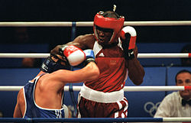
„Popular sports in Poland’’

Slide 9
„Popular sports in Poland’’
Boxing - a combat sport in which two players fight each other using only his fists.

Slide 10
The End

