Slide 1
Istituto Comprensivo «S. Giovanni Bosco» Naro - Italy

Slide 2
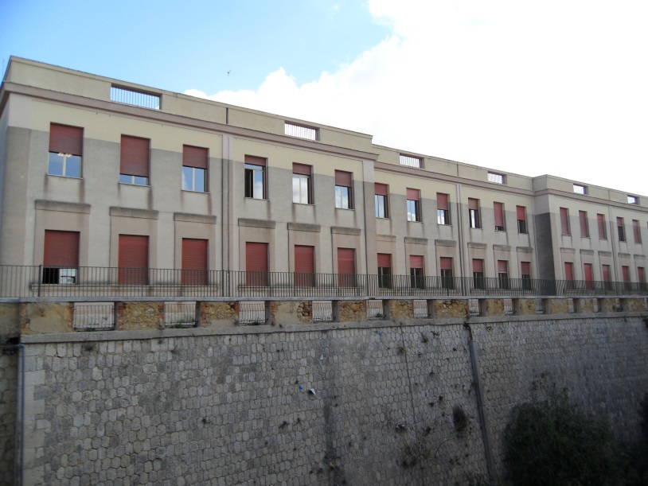
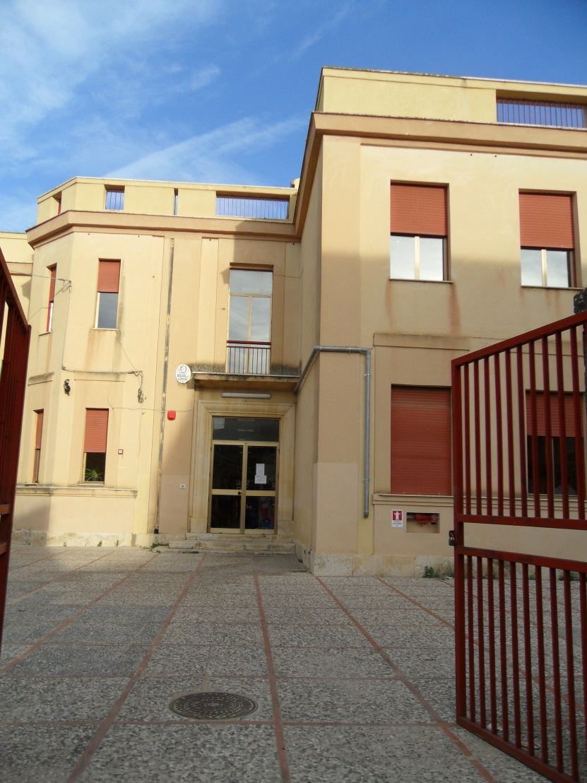
Welcome to our school!
It is located in two different towns, Naro and Camastra, and seven different complexes.
It includes the three levels of primary education : kindergarten, primary and first grade of secondary school.

Slide 3
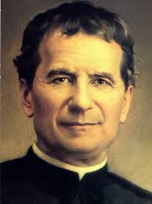
Who is he?
San Giovanni Bosco
(Known as don Bosco)
born in 1815 – Castelnovo D’asti
died in 1888 - Turin
priest of the Latin Church
educator and writer
dedicated himself to the education of disadvantaged youth
devoloped teaching methods based on love rather than punishment: Salesian preventive system
became a saint in 1934.

Slide 4
Istituto comprensivo S.Giovanni Bosco -facts-
NAME | PLACE | NUMBER OF CLASSES | NUMBER OF TEACHERS
KINDERGARTEN 3 years age 3 - 6 | Naro «San Secondo» Naro «San Calogero» Camastra «Edificio Nuovo» | 10 | 12
PRIMARY SCHOOL 5 years age 6 - 11 | Naro «S. G. Bosco» Naro «S.Secondo» Camastra «Edificio Nuovo» | 21 | 43
FIRST GRADE SECONDARY SCHOOL 3 years age 11 - 14 | Naro «S. Agostino» Naro «Riolo Specchi» Camastra «R. Livatino» | 13 | 36 Tot. 91

Slide 5
PRIMARY SCHOOL
FACTS | 21 classes
 | Year 1: age 6-7 | 4 classes
 | Year 2 : age 7-8 | 4 classes
 | Year 3 : age 8-9 | 4 classes
 | Year 4 : age 9-10 | 5 classes
 | Year 5 : age 10-11 | 4 classes
About 437 pupils
43 teachers
teachers mostly work in teams
Children with special needs are inclused in all classes
Children with special needs have a support teacher that operates in the class

Slide 6
TIME SCHOOL for pupils
Parents can decide time school for their children:
27 hours a week
30 hours a week
40 hours a week (if there are some specific conditions: canteen place…)
In our school:
children benefit of 27 teaching hours (4.5 hours x 6 days)
Time: 8.30am-13.00pm from Monday to Saturday
According to economic resources assigned to the school, children can attend special courses in the afternoon (sport or creative activities, English courses…)

Slide 7
Subjects taught: | Hours in a week
Italian | 7 hours
English | 1h class 1 2h class 2 3h classes 3-4-5
Maths | 5 hours
Science | 2hours
History Geography Social studies | 2hours 2hours 1 hour
Music | 2 hours
Art | 2 hours
Physical education | 2 hours
Religion | 2 hours
Information tecnology | 1 hour

Slide 8
Time school for teachers
In a W E E K
 | 22 hours of teaching
 | 2 hours for planning school activities on Tuesday afternoon

Slide 9
Education system in Italy
22/25 years
University
19 years
High School
Technical Institute
Professional
Training Institute
14 years
first grade of secondary school (compulsory)
11 years
Primary school (compulsory)
6 years
3 years
Kindergarten (not compulsory)

Slide 10
Primary education
level | name | duration | certificate awarded
Pre-school education | kindergarten Scuola dell'infanzia Not compulsory | 3 years, age 3 to 6
Primary education | primary school Scuola primaria compulsory | 5 years, age 6 to 11
Lower secondary education | first grade secondary school Scuola secondaria di 1° grado compulsory | 3 years, age 11 to 14 | Diploma di scuola secondaria di primo grado

Slide 11
WHERE ARE YOU?

Slide 12
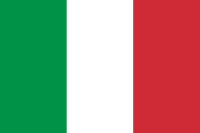
Our Flag: TRICOLORE
Green as our plains
White as the tops of our mountains
Red as the blood of our war dead
Capital: Rome
Population: 59.619.290
Area: 301 317 sq km
Regions: 20

Slide 13
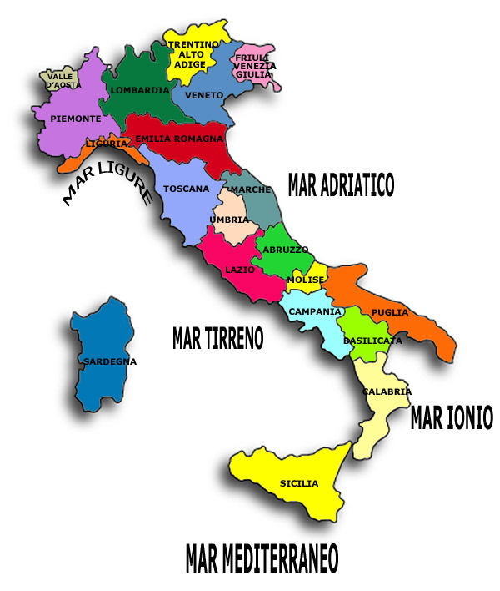
ITALY: What a strange shape!
Italy is a country located in Southern Europe, that comprises the two largest islands in the Mediterranean Sea, Sicily and Sardinia.
It is also called by Italians lo Stivale ("the Boot") or la Penisola ("the Peninsula").
Italy shares its northern alpine boundary with France, Switzerland, Austria and Slovenia.

Slide 14
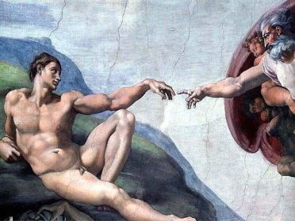
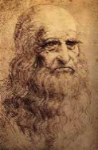
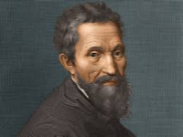
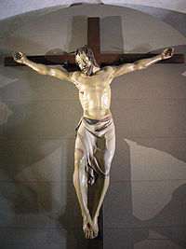
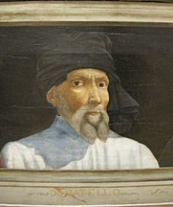
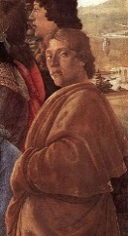
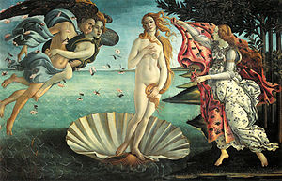
Culture in Italy
Italy has been a seminal place for many important artistic and intellectual movements that spread throughout Europe, including the Renaissance and Baroque.
The most important artists were :
Michelangelo
Leonardo da Vinci
Donatello
Botticelli

Slide 15
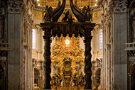
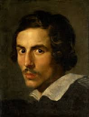
Bernini
Caravaggio
Raphael
… among many others.

Slide 16
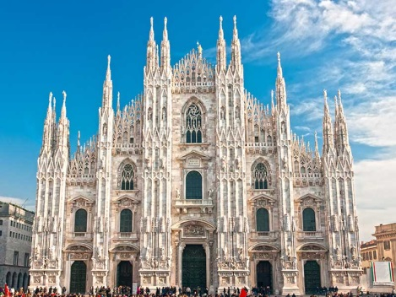
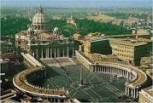
MAIN CITIES
The italian cities have a lot of works of art and other important monuments.
In Milan we can see the dome, work of art gothic that with its gold “madonnina” is become the symbol of the city.
In Rome the “Colosseo” with S. Peter square, seat of Vatican, contribute to make the city famous in the world.
Florence is important for its “Uffizi” and the “David” of Michelangelo.
Currently Italy is the country that has the largest number of sites, 49, included in the list of UNESCO World Heritage.

Slide 17
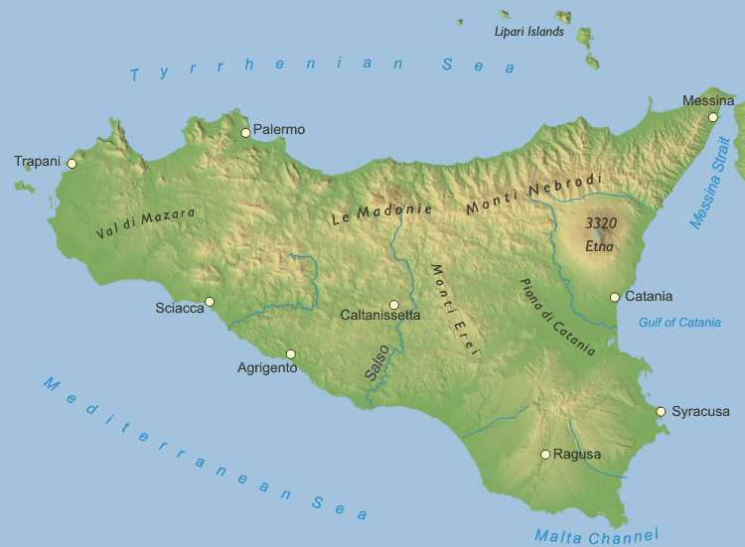
In the middle of the Mediterranean Sea…
There is an island which has been visited and sometimes conquered by several civilizations :
the Phoenicians, Greek, Romans, Byzantine, Arabs, Normans, Spanish…
…S I C I L Y

Slide 18
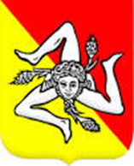
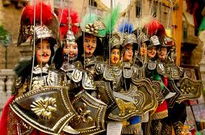
A land cradle of art
Of the 49 sites present in Italy, six are found in Sicily, reflecting the significant value of the historical, artistic and natural heritage of the region.
In 2008, in the list of "Intangible Cultural Heritage of Humanity“ Unesco added the “Opera dei Pupi” and, in 2009, the Mediterranean diet .

Slide 19
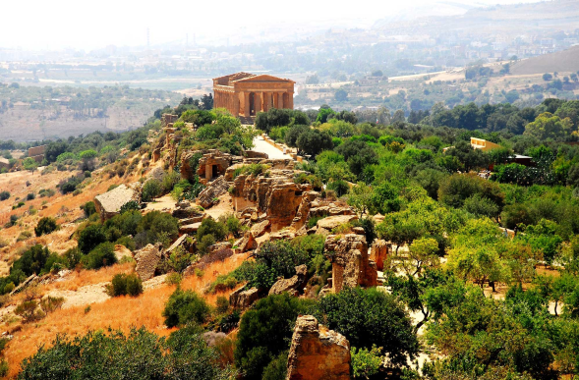
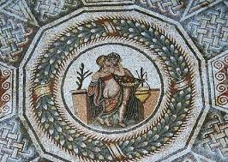
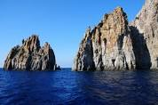
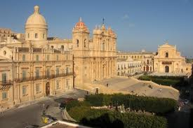
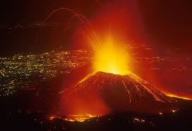
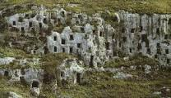
UNESCO WORLD HERITAGE in SICILY
Archaeological Area of ​​Agrigento, recorded in 1997.
Enna, Piazza Armerina, Villa del Casale, recorded in 1997
The Aeolian Islands, recorded in 2000
The Baroque towns of the Val di Noto, recorded in 2002
Syracuse and the Rocky Necropolis of Pantalica, recorded in 2005
Mount Etna registered in 2013

Slide 20
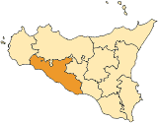
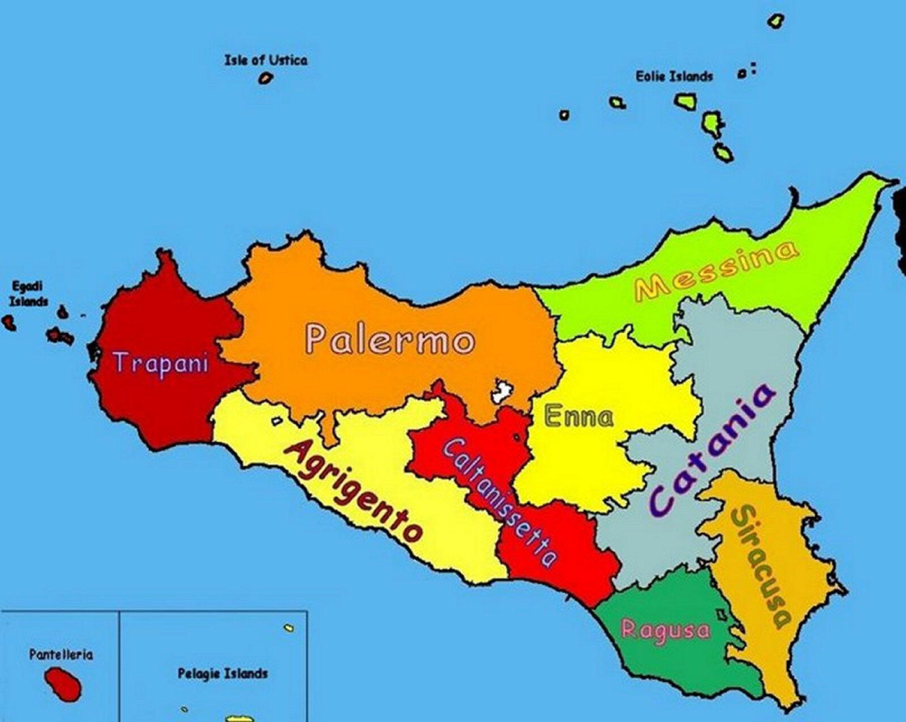
AGRIGENTO
founded on a plateau overlooking the sea, around 582-580 b.C.
his establishment is attributed to Greek colonists who named it Akragas.
famous for an important archaelogical site, the Valley of Temples, one of the most outstanding examples of Greater Greece art and architecture.
AGRIGENTO
AGRIGENTO

Slide 21
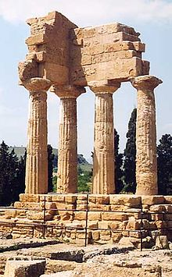
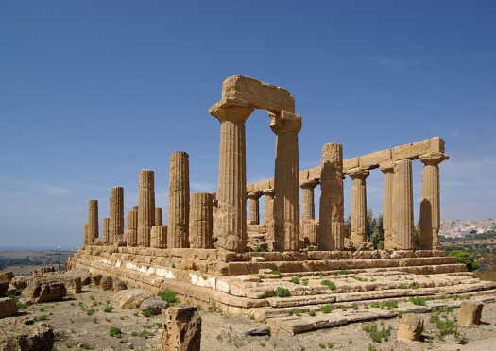
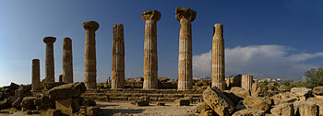
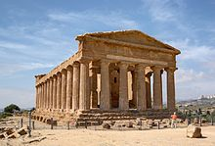
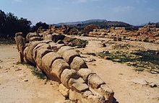
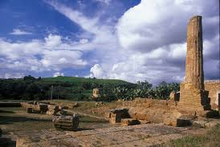
The VALLEY of TEMPLES
seven monumental Greek temples in the Doric style, constructed during the 6th and 5th centuries BC.
they constitute some of the largest and best-preserved ancient Greek buildings outside of Greece itself.
The temples are:
Temple of Juno Temple of Heracles Temple of Castor and Pollux
Temple of Concordia Temple of Olympian Zeus Temple of Vulcan

Slide 22
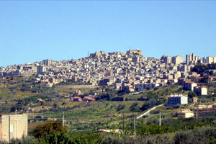
Naro : the city of baroque
25 km away from Agrigento
positioned on a hill
about 8,500 inhabitants.
underwent many dominations
(Greek, Carthaginians, Romans, Byzantines, Arabs Norman
pearl of Agrigento’s baroque
economy primarily agricultural.

Slide 23
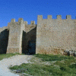
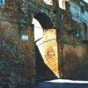
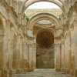
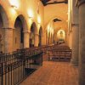
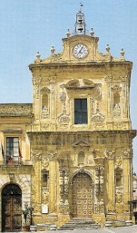
Main monuments : Medieval itinerary
CHIARAMONTE CASTLE
GOLDEN GATE
OLD NORMAN CHURCH
Naro is very rich in history, as evidenced by the
monuments and works of art.
S. FRANCESCO
CHURCH OF ST. CATHERINE

Slide 24
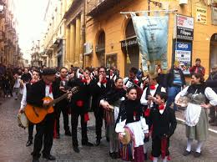
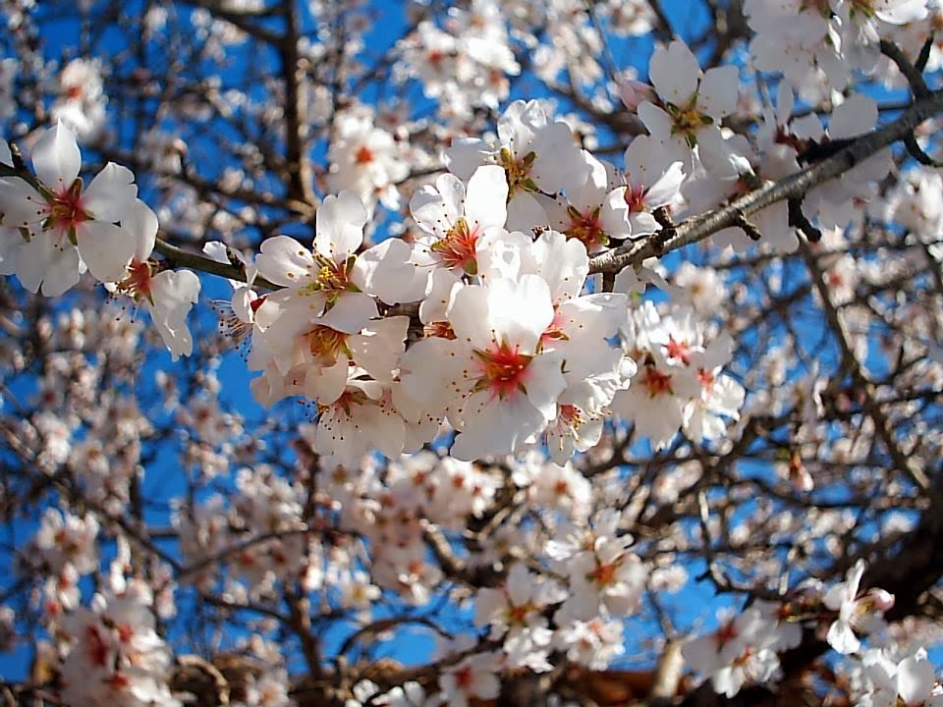
Famous for…
PRIMAVERA NARESE
Rejoices the arrival of the springtime picturesque season
Rural festival with the exhibition of local and international folk dance groups
born in Naro,in 1938, in the spectaculary scenary of «PARADISE VALLEY», with its white blossomed almonds.
Later on, it was handed to Agrigento and it became the famous:
Almond blossom festival
(Sagra del mandorlo in fiore)

Slide 25
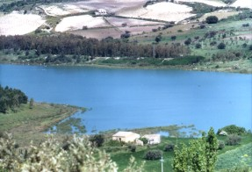
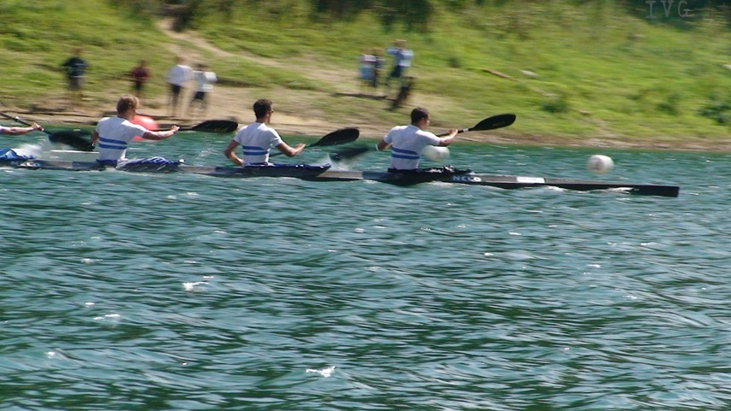
Lake St. John
few kilometers away from the town center hosted tournaments boating European and international level.

Slide 26
THE END

Slide 27
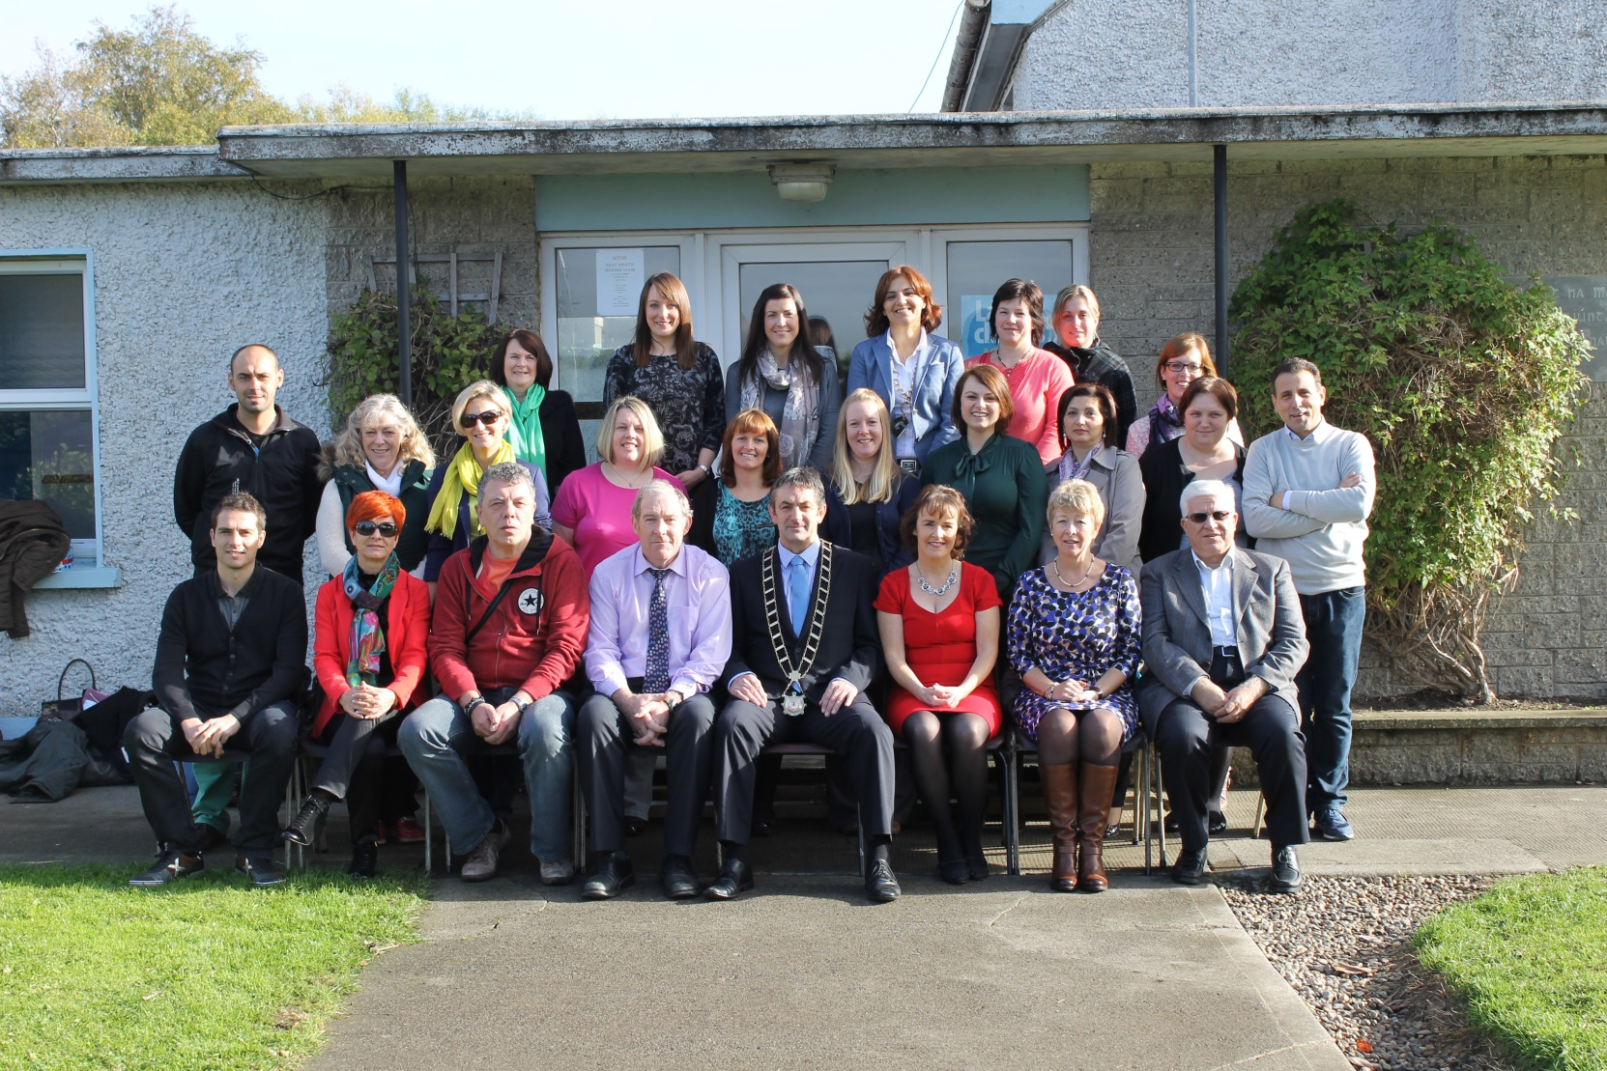
Welcome to you all!

