Slide 1
POPULAR SPORTS IN POLAND

Slide 2
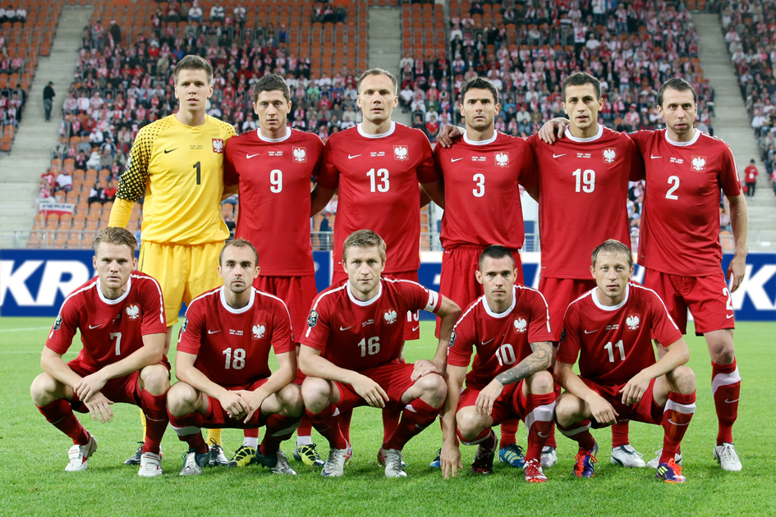
FOOTBALL
This is our national team.

Slide 3
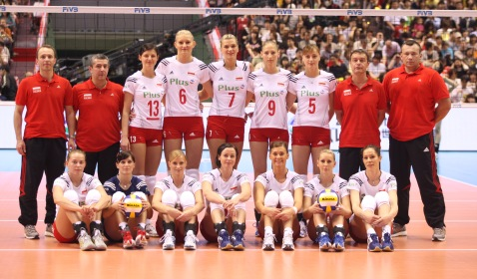
VOLLEYBALL
This is our woman’s team.

Slide 4
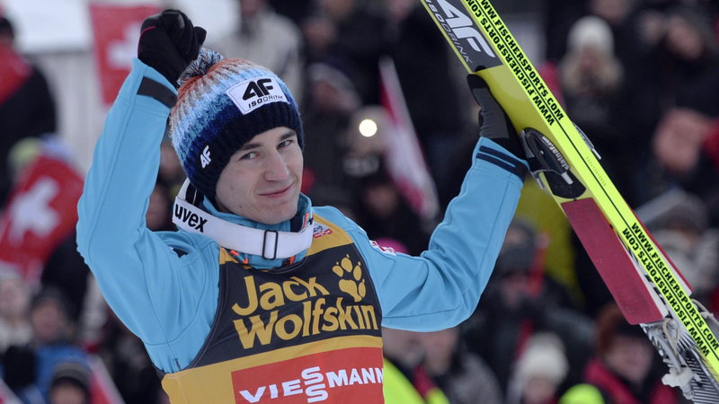
SKI JUMPING
This is Kamil Stoch.

Slide 5
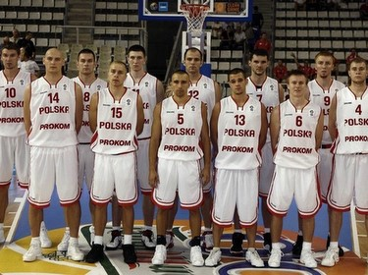
BASKETBALL
This is our men’s basketball team.

Slide 6
TENNIS
This is Agnieszka Radwańska.

Slide 7
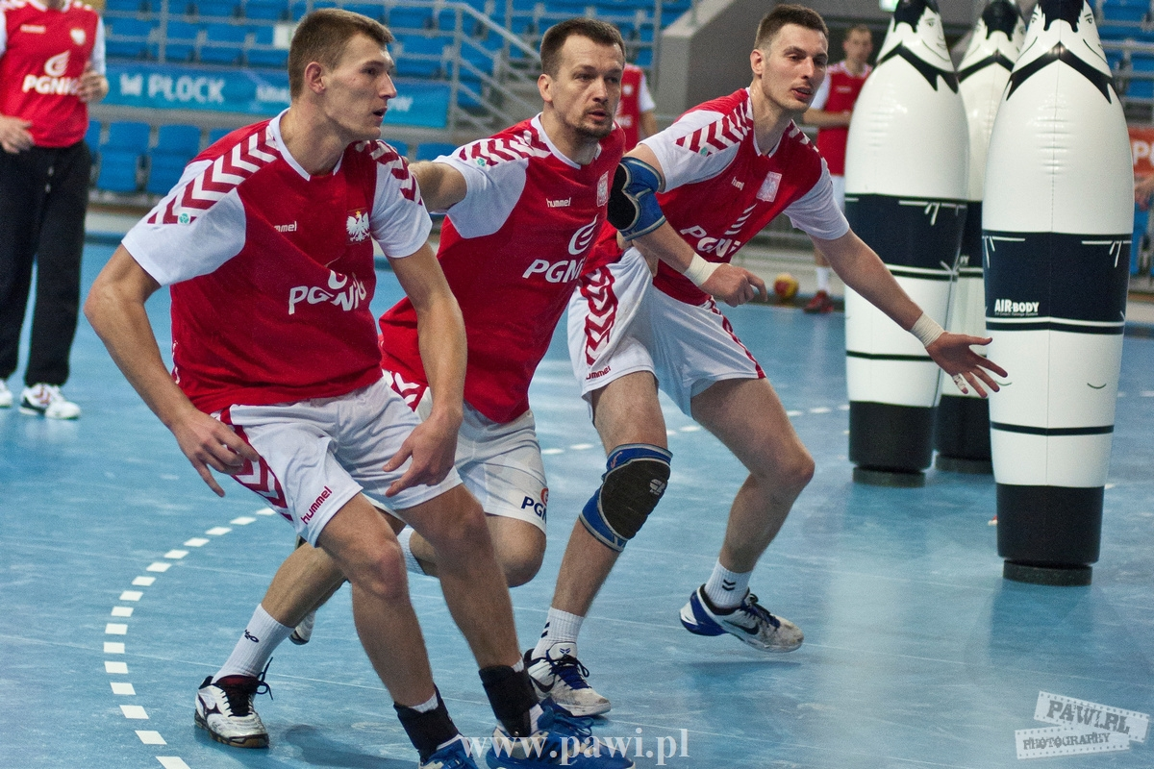
HANDBALL
This is our man’s handball team.

Slide 8
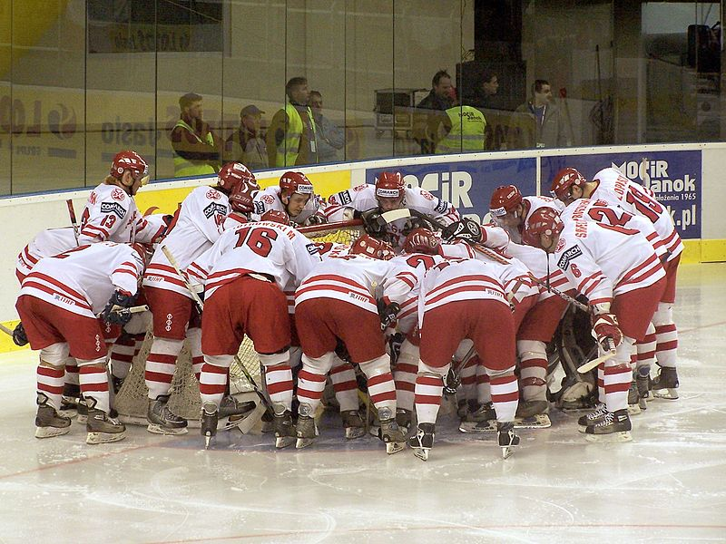
ICE HOCKEY
Our National Team in ice hockey.

